Slide 1
Midlende nivåregulering av buffertank (eng.: averaging level control...)
IA3112 Automatiseringsteknikk Høsten 2017
Av Finn Aakre Haugen
(finn.haugen@usn.no)

Slide 2
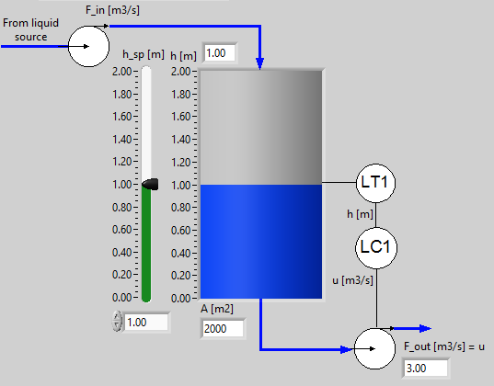
Buffer tank with a level control system
Aim: Averageing (or equalizing, or attenuating) inflow variations so that the outflow becomes smoother than the inflow.
2

Slide 3
Example of application (results shown at end of this PPT): Level control of equalization magazine upstreams the
VEAS water resource recovery facility (wrrf) or resource recovery facility (wrrf), at Slemmestad, south of Oslo, Norway:
3

Slide 4
How to tune LC?
4
We need a sluggish or soft or compliant LC so that the liquid volume (the level) can take up the inflow variations.
Ziegler-Nichols is useless here since it gives fast or stiff control :-(
But Skogestad is excellent, using Tc as tuning parameter :-)
K_{c} = 1/(K_{i}*T_{c}) T_{i} = 2*T_{c}
where K_{i} = -1/A is the integrator gain or normalized process step response.
How to select T_{c}?

Slide 5
...
How to select Tc?
5
As a start, assume P (proportional) level controller. It can be shown, from a mathematical model of the level control system, that
Δh_{max} = (Tc/A)*ΔF_{in}
where Δh_{max} is corresponding maximum allowed level change (in steady state) after max inflow step change, ΔF_{in}.
With a PI controller with the same Tc:
Δh_{max} <= (Tc/A)*ΔF_{in}
Solving this inequality for Tc gives
Tc >= A* Δh_{max}/ΔF_{in}
=> Specification of Tc in the PI settings:
Tc = A* Δh_{max}/ΔF_{in}

Slide 6
Comparison of responses in level h
due to step change in inflow Fin, with P and with PI controllers:
6

Slide 7
Example
7
Assumptions:
A = 2000 m2
ΔF_{in} = 1 m3/s
Δh_{max} = 0.5 m
Resulting Tc:
Tc = A* Δh_{max}/ΔF_{in} = 2000*(-0.5)/(-1) = 1000 s
PI settings:
K_{c} = 1/(K_{i}*T_{c}) = -A/T_{c} = -2000 m2 / 1000 s = 2.0 (m3/s)/m
T_{i} = 2*T_{c} = 2*1000 s = 2000 s

Slide 8
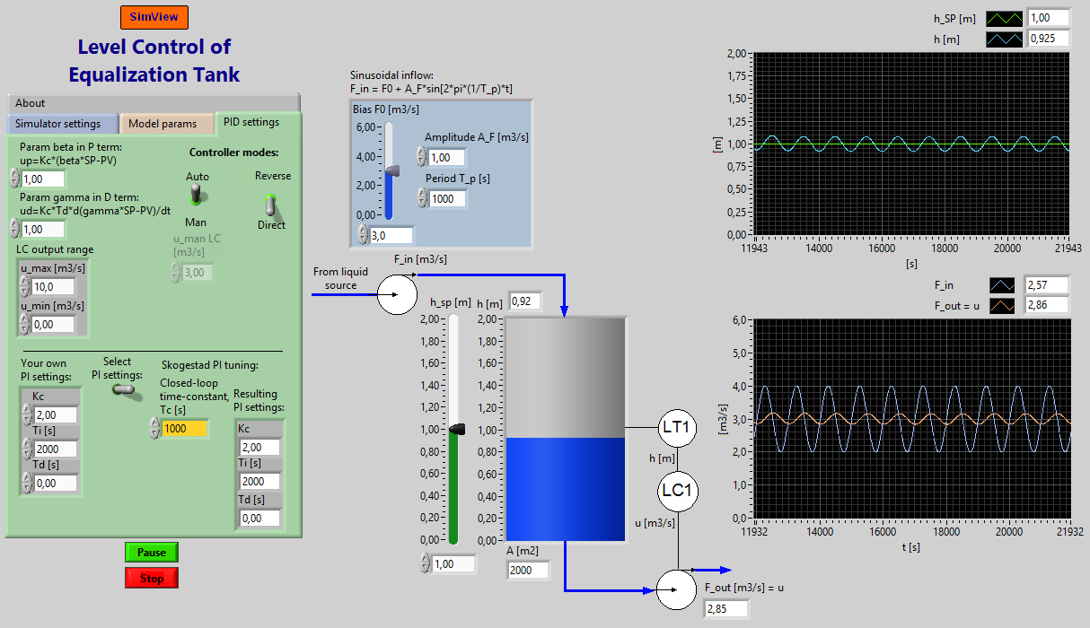
8
Simulation!

Slide 9
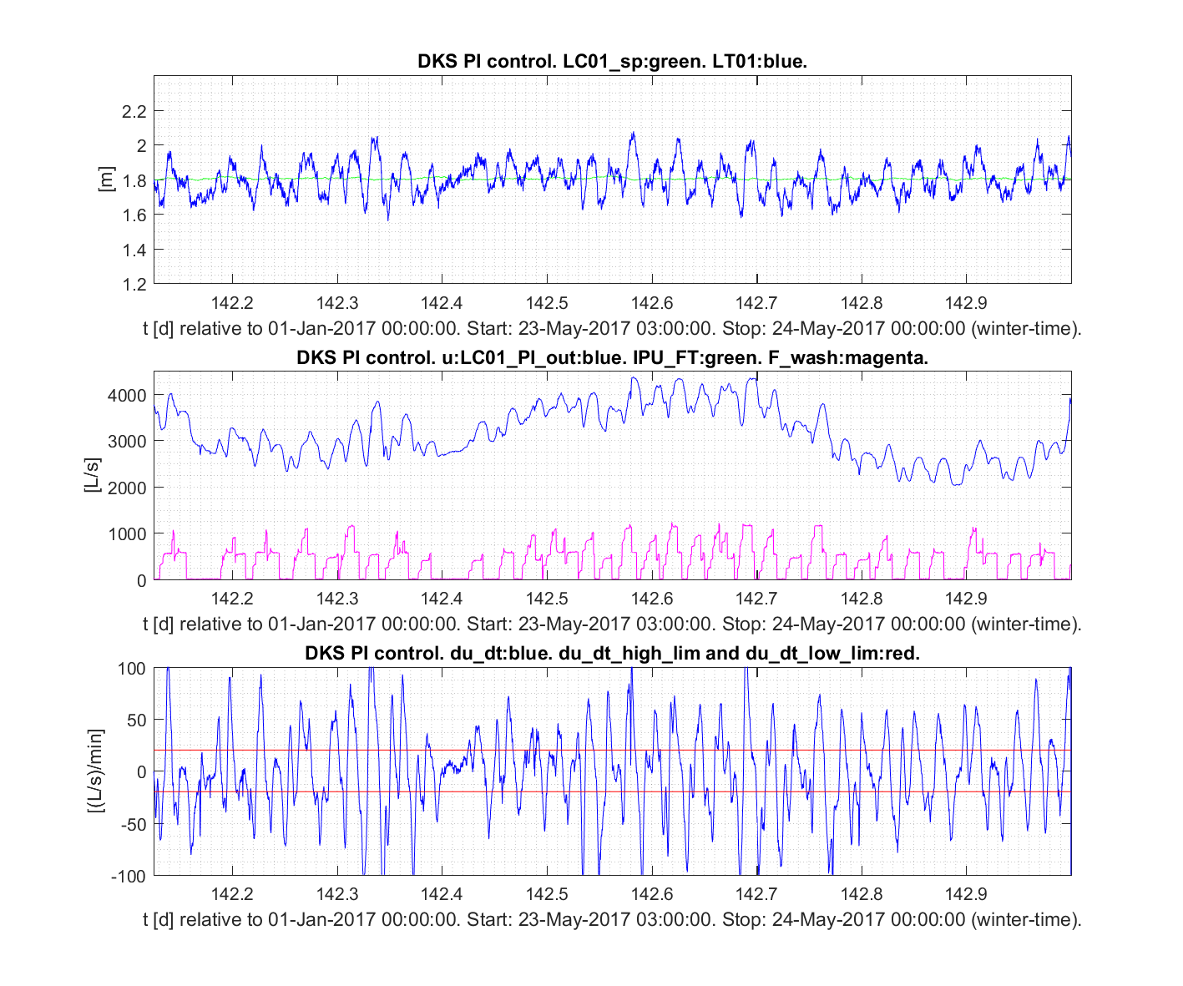
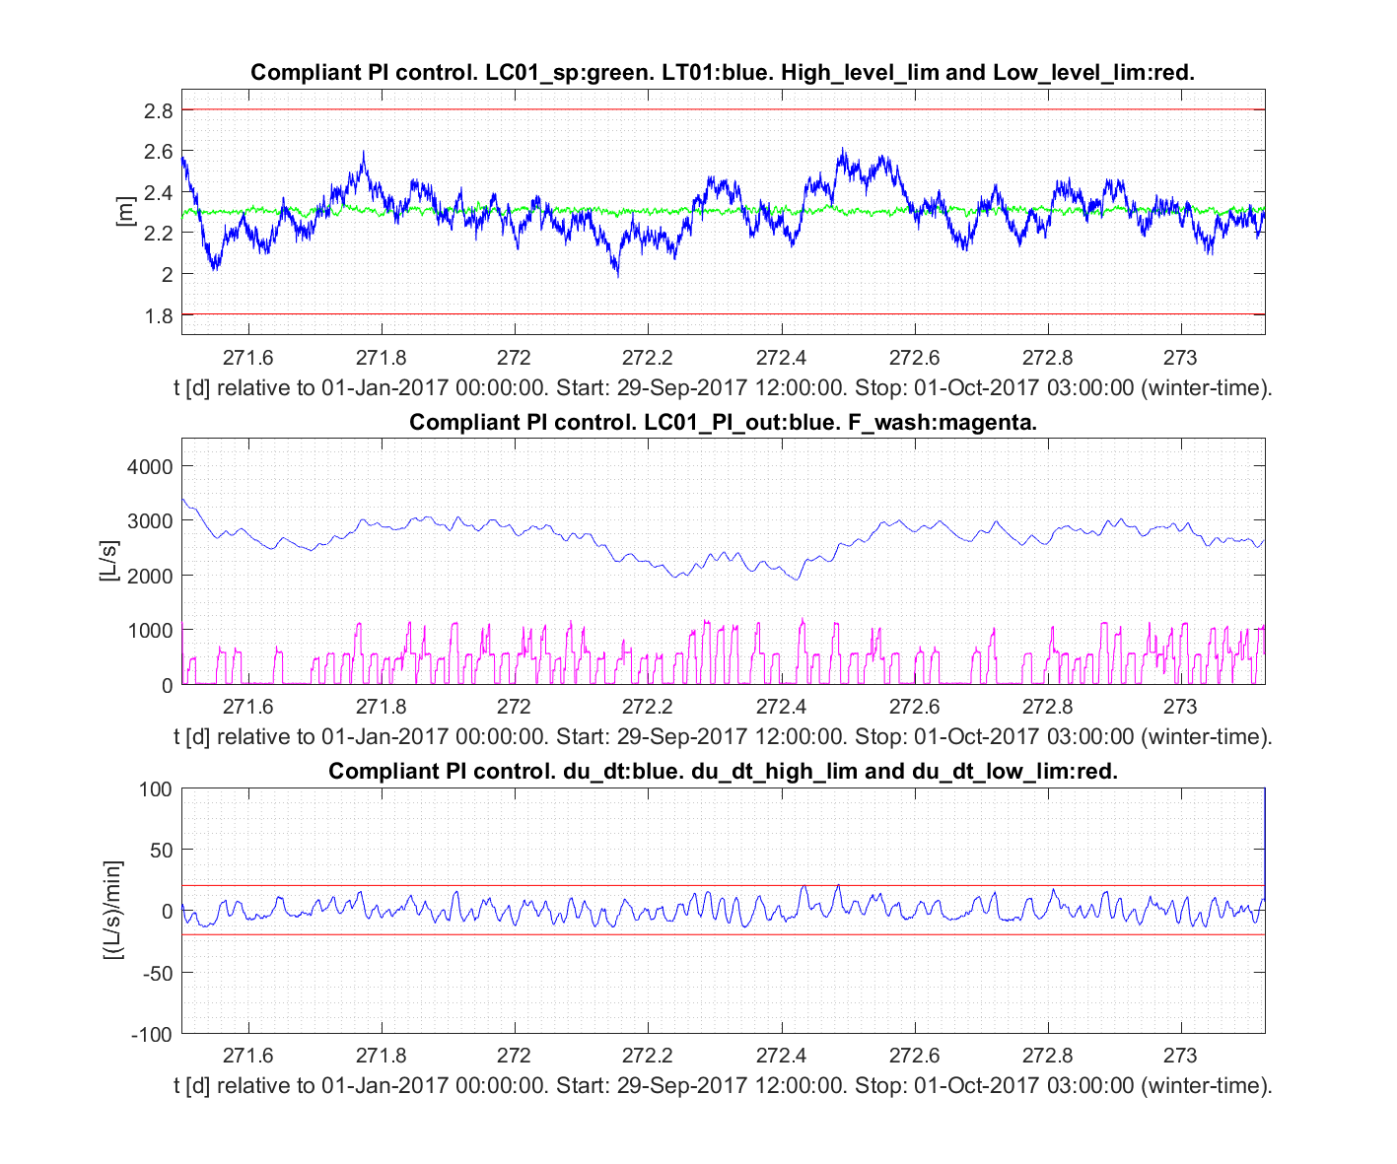
9
Results from VEAS:
With original PI settings in the LC
(Kc = 8.0 , Ti = 1000 s)
With new (Skogestad) PI settings in the LC (Kc = 3.1 , Ti = 3240 s)
Pump flow
Much smoother pump flow

