Slide 1
Gain scheduling
IA3112 Automatiseringsteknikk og EK3114 Automatisering og vannkraftregulering
Høstsemesteret 2017
Av Finn Aakre Haugen
(finn.haugen@usn.no)

Slide 2
2
Problem: Assume that the dynamic properties of the process to be controlled vary with the operating point. With fixed PID settings, the control system may
get poor stability, or
become sluggish
Solutions:
Conservative tuning (good stability, but sluggish control)
Adaptive tuning (optimal settings all the time, i.e. the control system gets good stability and fast control):
Model-based PID parameter adjustment
Gain scheduling based on experiments
Here, we concentrate on Gain scheduling.

Slide 3
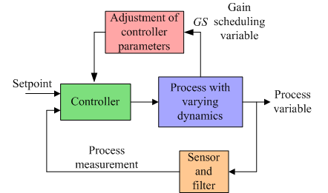
3
Control system with controller parameter
updating using Gain scheduling:

Slide 4
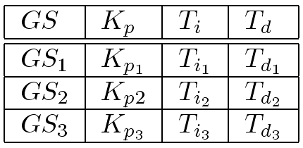
4
Gain schedule
= Table of sets (here 3) of PID parameter values:
PID set 1
PID set 2
PID set 3

Slide 5
5
How to interpolate between the tabular values of
controller parameters and GS variable?
Let's focus on controller gain Kp (the same principles apply to Ti and Td as well).
PID set 1
PID set 2
PID set 3

Slide 6
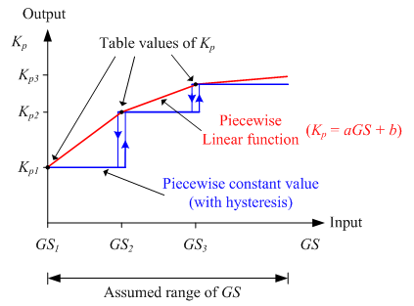
6
How to interpolate between the tabular values of
controller parameters and GS variable?

Slide 7
7
An example: Temperature control system
where process dynamics varies with flow

Slide 8
8
In the example:
How do process parameters depend on flow?
Responses in temperature after 10% step in control signal to heater:
Large flow (24 kg/min)
Small flow (12 kg/min)
Process gain
~
Inverse of flow
Time constant
~
Inverse of flow
Time delay
~
Inverse of flow

Slide 9
Observations (from previous slide):
Process gain
~
Inverse of flow
Time constant
~
Inverse of flow
Time delay
~
Inverse of flow
Implication: When PID controller has fixed parameters:
If flow is reduced, the stability of
the control loop is reduced.
How to maintain stability and speed of the control system despite flow variations?
By adjusting the controller parameters based on flow measurement!
So, flow is selected as GS variable.

Slide 10
10
Simulator:
Gain scheduling

