Slide 1
Cascade control
Course IIA1117 Control Engineering Fall 2017
By Finn Aakre Haugen
(finn.haugen@usn.no)

Slide 2
Benefit of cascade control (comparing with ordinary single loop control):
Faster (more effective) compensation of process disturbances.

Slide 3
Review: Single-loop control system
3

Slide 4
4
Improved structure with faster (more effective) disturbance compensation:
Cascade control system

Slide 5
Interpretation: With cascade control, the original actuator
is substituted by a "new" well-behaving" actuator:

Slide 6
Controller tuning:
First, tune the secondary controller (with the primary controller in Manual mode).
Then, tune the primary controller (with the secondary controller in Auto mode).

Slide 7
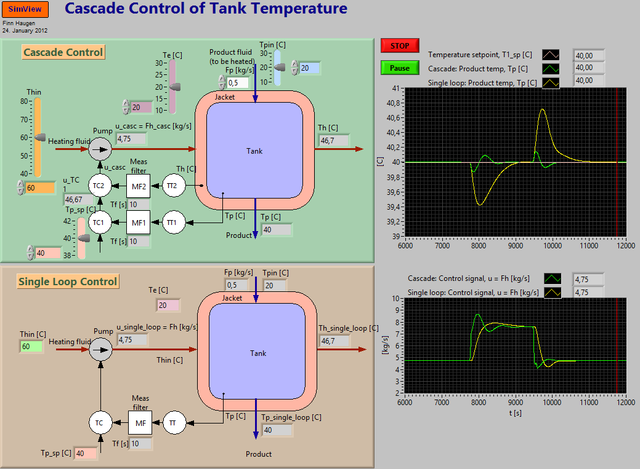
Example 1: Cascade control of temperature in a vessel
7
Simulator (unzip all the files, and then run the exefile).

Slide 8
Example 1 cont.: Comparing performance indexes IAE (Integral of Absolute value of control Error):
Excitation
Single-loop
Cascade
Their ratio
(Sprang = step)
(Forstyrrelse = disturbance)
Which of the control structures is the best?

Slide 9
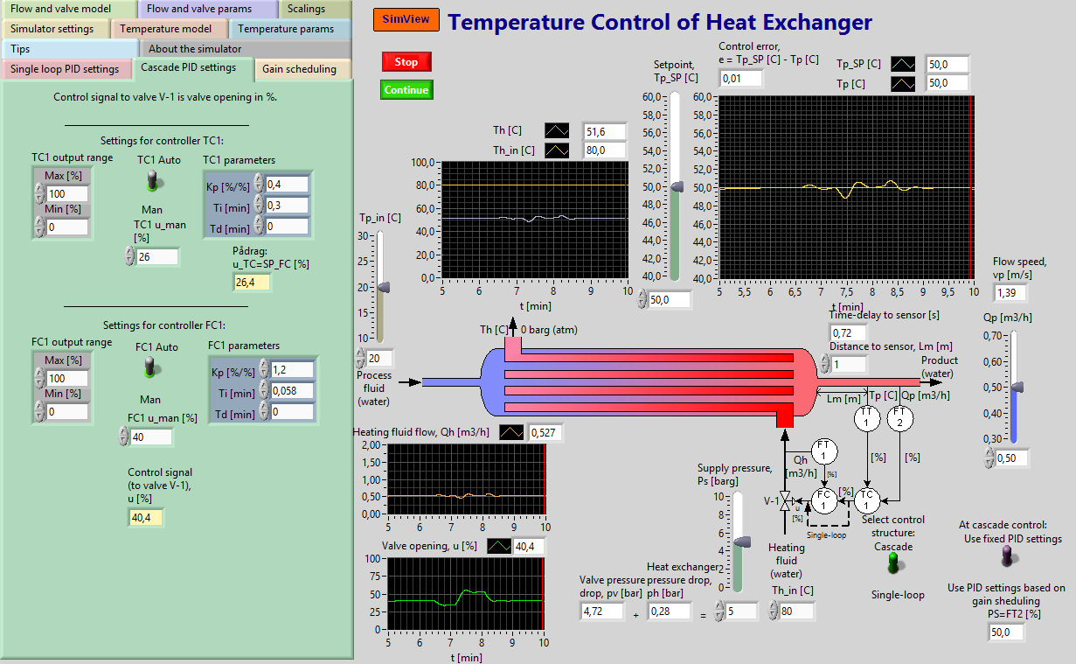
Example 2: Cascade control of heat exchanger
Simulator

