Slide 1

Actuators
Course PEF3006 Process Control
Fall 2017
By Finn Haugen
(finn.haugen@usn.no)

Slide 2
Where is the actuator in the control loop?
Valves
Pumps
Motors
Heaters

Slide 3
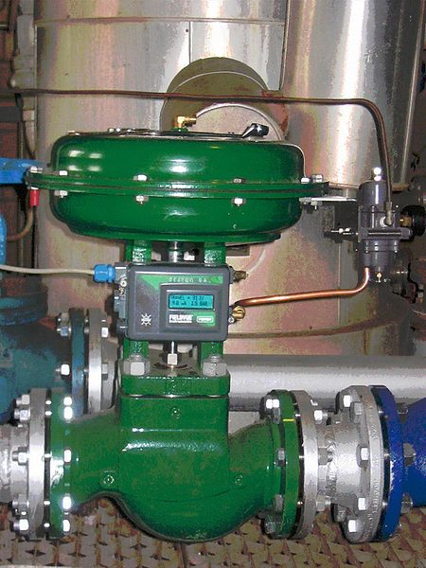
Control valve
Here is a pneumatic
control valve, using air pressure to manipulate the valve opening.
Valves are used to manipulate gas and liquid flows.
[http://en.wikipedia.org/wiki/Control_valves]

Slide 4
Principal design
of a pneumatic
control valve:
Control valve
Air pressure supply
Control air pressure
Control signal
(from controller)
IP-converter (from current (I) to pressure (P))
Spring
Indicator displaying valve opening
Packing box
Plug
Seat
Fluid outlet
Fluid inlet
[http://nn.wikipedia.org/wiki/Reguleringsventil + FH]

Slide 5
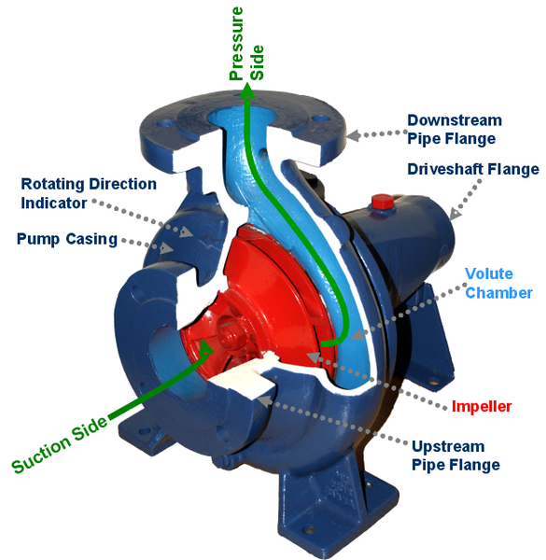
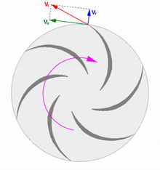
Centrifugal pump:
The most common pump type in industry.
[http://en.wikipedia.org/wiki/Pump]

Slide 6
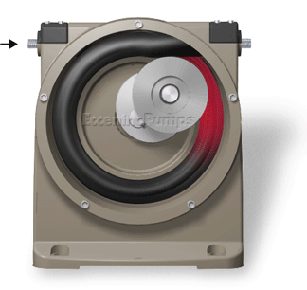
Peristaltic pump (displacement pump):
Applied for small, precise liquid flows, in dosing applications. Rotational speed is manipulated with voltage or current.
[http://en.wikipedia.org/wiki/Pump]

Slide 7
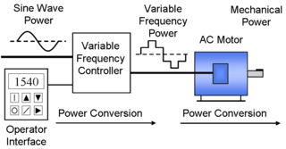
AC-motors are controlled (manipulated) by frequency converters.
AC-motors
(Fans; Pumps; Conveyors; Compressors.)
[http://en.wikipedia.org/wiki/Electric_heating]

Slide 8
Example: Motor control
The purpose of a frequency converter is to convert the "fixed" alternating mains voltage (e.g. 230 V, 50 Hz) to an alternating voltage with variable amplitude and frequency appropriate to control the rotational speed of an AC-motor.

Slide 9
Actuator: Heating element (resistor)
It can be manipulated using PWM... (next slide)
[http://en.wikipedia.org/wiki/Electric_heating]

Slide 10
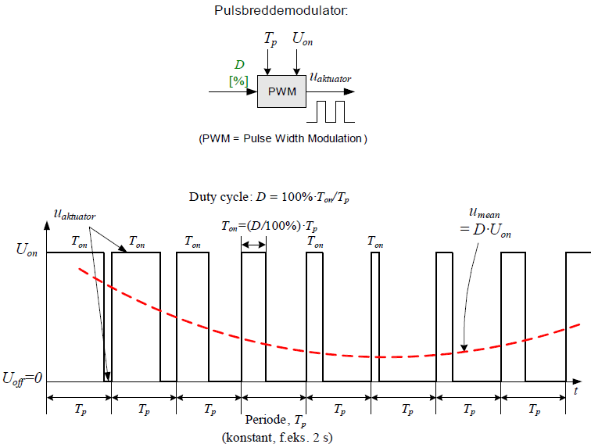
Principle of pulse-width modulation (PWM) :
Purpose of PWM: To deliver approximately continuous (analog) power to a process using relatively quick On/Off-switching of the power source.
Typical applications are electrical heaters and motors.

Slide 11
Application of PWM for temperature control
The SSR (Solid State Relay) switches the mains in/out over the heating element. In average the process receives power which is proportional to the control signal from the PID controller, hence analog power supply, even if the power is actually turned on/off!

Slide 12
Simulator of PWM-controlled actuator in a
PID control system

