Slide 1
Tuning of PID controllers
Course PEF3006 Process Control Fall 2017
By Finn Aakre Haugen
(finn.haugen@usn.no)

Slide 2
2
Ziegler-Nichols'
closed loop method

Slide 3
Aim of tuning:
As fast control as possible,
but with
acceptable stability, i.e. ¼ decay ratio
3
Disturbance step:
A2/A1 = 1/4
Response in controlled
process output:

Slide 4
4
Experimental setup in Ziegler-Nichols’ method:

Slide 5
Tuning procedure of Ziegler-Nichols’ method:
5
With controller in manual mode: Bring the process to the specified operating point by manually adjusting the control variable until the process variable is approx. equal to setpoint.
Turn PID controller into P controller with gain Kp = 0. (Ti = very large. Td = 0.)
Set the controller to automatic mode.
Increase gain Kp (you may start with Kp = 1) until there are steady oscillations in the loop due to a small setpoint step. This controller gain value is the ultimate gain, Kpu. Read off the period, Pu, of the oscillations.
Calculate controller parameters from the Z-N formulas:
Recommends "Relaxed ZN PI-tuning" (cf. article by FH og B. Lie in Modeling, Identification and Control):
Kp = 0,32*Kpu og Ti = Pu.

Slide 6
6
Let’s try Z-N tuning of a PI controller on this simulator:
Level control of wood-chip tank

Slide 7
7
Auto-tuning
(automatic PID tuning)

Slide 8
Example of auto-tuner: The Relay or On/Off tuner (by Åström and Hägglund). Sustained oscillations come automatically in control loop. From the amplitude and the period of these oscillations proper PID controller parameters are calculated by an algorithm in the controller.
Amplitude A
Amplitude Y
Period Pu
In Ziegler-Nichols’:
Use Pu and Kpu = 4*A/(pi*Y).

Slide 9
9
Example:
Relay-tuning of a PI temperature controller:
Temperature Control of Liquid Tank

Slide 10
Skogestad’s PI-tuning for a
”integrator with time-delay” process
Find model parameters K and tau from process step response
(or from a mathematical process model, if you have one):
(If time-delay is disregarded)
PI controller settings:
Kp = 1/[Ki*(Tc + tau)] = 1/(2*Ki*tau) if Tc = tau.
Ti = 2(Tc + tau) = 4*tau if Tc = tau.
Skogestad uses 4 in stead of 2 in the Ti formula, but you get faster disturbance compensation with 2.
If you do not know how to specify Tc, Skogestad suggests Tc = tau.
But if the process has negligible tau, you can not set Tc = tau. Then you must select Tc by yourself.

Slide 11
11
Skogestad's method

Slide 12
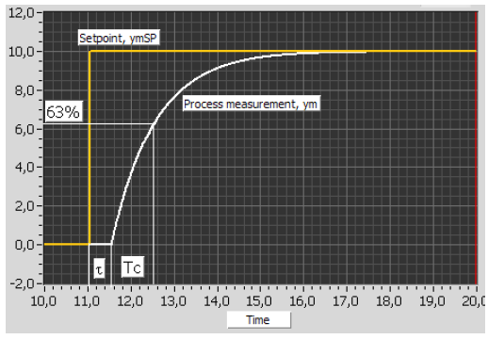
Skogestad’s method is a model-based method, but the model parameters may stem from a
simple step-response test on the process.
You must specify the time-constant Tc of the closed-loop system (illustrated below with setpoint step response):
tau is
process
time-delay

Slide 14
14
Let’s try
Temperature control of liquid tank

