Slide 1
State estimation (Kalman filter)
Course PEF3006 Process Control Fall 2017
Av Finn Aakre Haugen
(finn.haugen@usn.no)

Slide 2
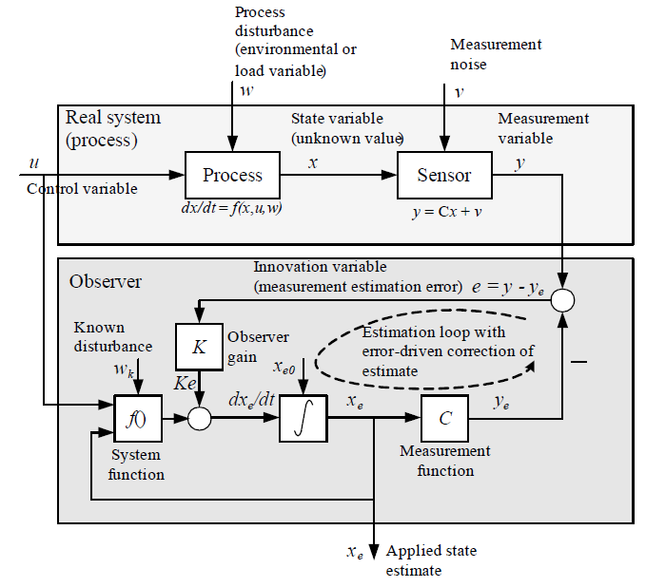
A prosess with a state estimator:
Real process
A state estimator (or observer) is
in principle a real-time process simulator that runs on a computer, in parallel with the physical process. The states of the simulator (estimator) are updated by the error or deviation between of the real measurement and the simulated (predicted) measurement.
State estimator
or observer
Literature for further reading.

Slide 3
Example: Kalman-filter for estimation of the states of
a biogas reactor Article:
State Estimation and Model-Based Control of a Pilot Anaerobic Digestion Reactor
(https://www.hindawi.com/journals/jcse/2014/572621/)

Slide 4
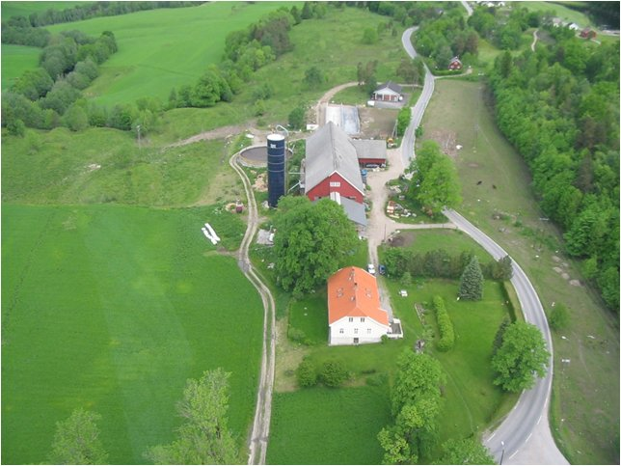
Foss Farm (Skien, Norway)

Slide 6
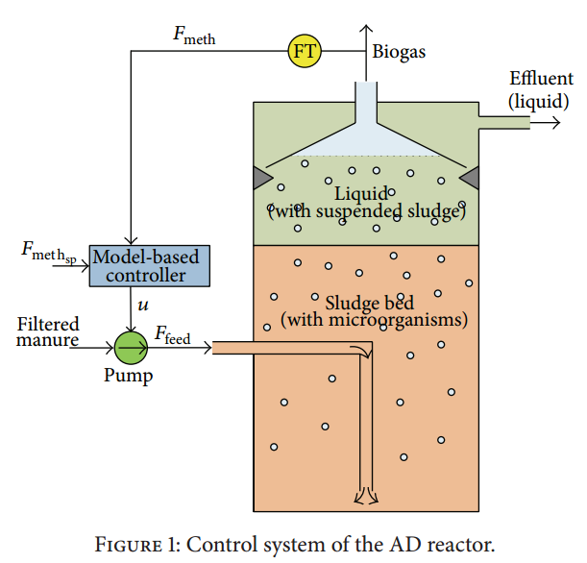
The process (biogas reactor):

Slide 7
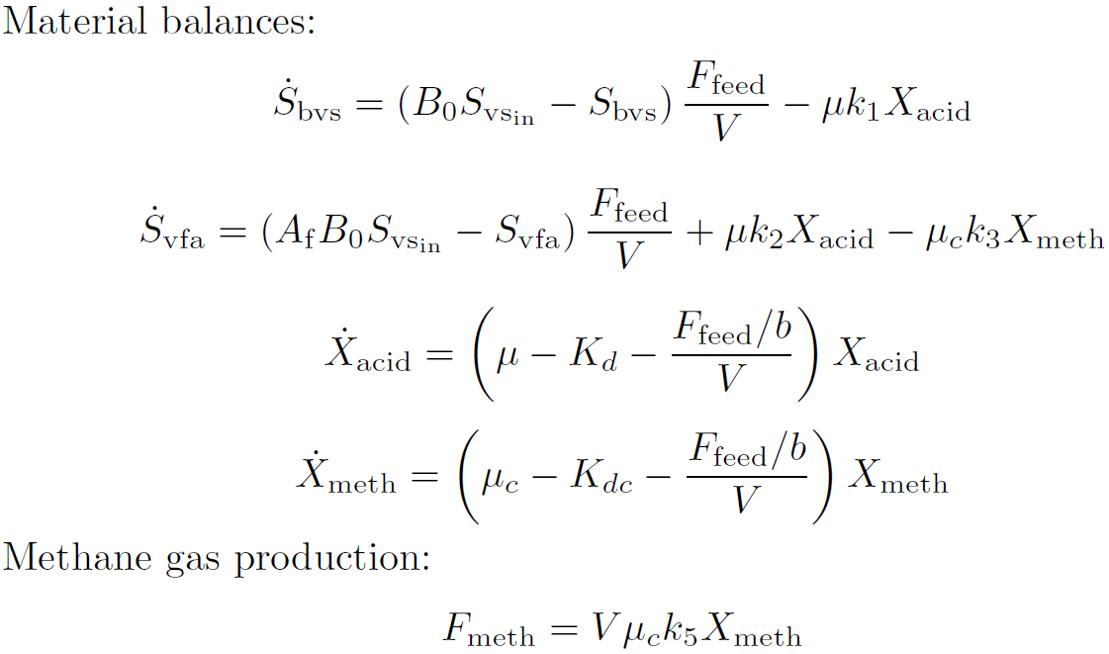
AD model used: «Modified Hill model»
(Hill, 1983, Haugen et al., 2013)

Slide 8
Results with Kalman Filter:

Slide 9
Example:
Kalman-filter for estimation of
the outflow of a simulated water tank
http://techteach.no/simview/kalmanfilter

