Slide 1

Model-based Predictive Control
(MPC)
Course PEF3006 Process Control
Fall 2017
By Finn Aakre Haugen
(finn.haugen@usn.no)

Slide 2
"MPC is the only advanced control technique that is more advanced than standard PID to have a significant and widespread impact on industrial process control."
J. M. Maciejowski in Predictive Control with Constraints (2002).

Slide 3
History
Cutler and Ramaker (Shell Oil), 1973: DMC (Dynamic Matrix Control). 1983: QDMC (Quadratic DMC). Application to furnace temperature control.
Richalet et al., 1976: Algorithm: MPHC (Model predictive heuristic control). Software: IDCOM (Identification and Command). Applied to a fluid catalytic cracking unit and a PVC plant.

Slide 4
Some (very few) MPC products
DeltaV (Emerson Process Partner)
800xA APC (ABB)
Matlab MPC Toolbox, also for Simulink
LabVIEW Predictive Control palette in Control Design toolkit
Septic (Statoil, no external use)
.
.
.

Slide 5
What is MPC?

Slide 6
The optimal control signal applied to the actuator.
Calculated, but not applied to the process.
ySP
The optimal control sequence is calculated by the MPC.
ypred
u(2)
u(0)
u
u(1)
Now!
Future
For example:
Np = 20 (samples)

Slide 7
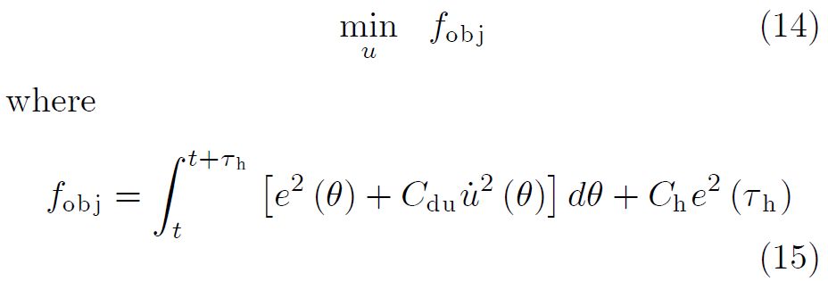
MPC as a mathematical problem:
Prediction horizon
Costs
Control error
= Setpoint - Meas
Control signal change
t = time now!
This is a QP problem!
(Quadratic Programming = quadratic optimization)
Question: Is this particular criterion fobj reasonable?
Q: Is ySP known?
Q: How to calculate ypred?
Q: Do we need the present state of the process?
Q: If so, how can we get it?

Slide 8
Generally speaking (actually, not thinking about MPC here):
Minimization with Matlab:
Resulting
minimum of
fobj
Resulting
optimal variable
Optim variables
(their optimal values
is to be found)
Optim objective
(to be minimized)
[fobjmin,uopt] = fmincon(fobj,uguess,...)
fmincon selects a proper optim algorithm automatically, e.g. SQP (Sequential Quadratic Programming).
fmincon searches for the to uopt using a number of iterations of its algorithm. At each iteration f is coming closer to fmin, i.e. u is coming closer to uopt.

Slide 9
fmincon-formulation of the MPC problem:
f = Sum{ [e(k)]^2 + Cdu*[Δu(k)]^2 }
u = {u(0), u(1),...,u(N)}
fmincon finds the optimal control sequence,
u_opt = {u(0), u(1),...,u(N)},
from a number of simulations of the process model. At each iteration in the search for u_opt, fmincon simulates the process. fmincon decides itself how many iterations (simulations) are needed to find u_opt (the number of iterations is not in advance). Once fmincon has found u_opt, u(0) (the first element in u_opt) is applied to the process.
The aboove procedure is repeated at each point of time (i.e., at each time step).

Slide 10
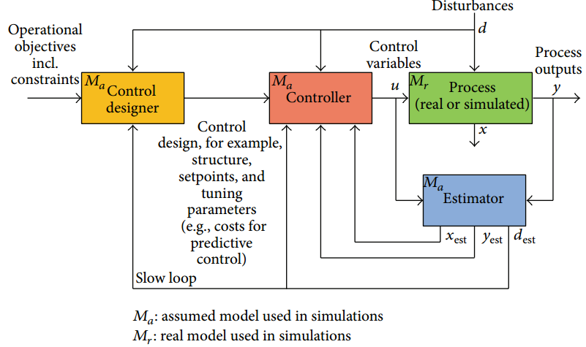
Often, a state estimator in the form of a Kalman Filter algorithm is used to provide the present state value and other "soft" measurements for the MPC:
MPC
Process
Kalman Filter

Slide 11
Summary of MPC:
The MPC is a model-based controller that, continuously predicts the optimal future control sequence using the following information:
An optimization criterion that typically consists of a sum of future (predicted) squared control errors and quadratic control signal changes.
A process model
The current process state obtained from measurements and/or state estimates from a state estimator which typically is in the form of a Kalman filter.
Current, and, if available, future setpoint values and process disturbance values.
Constraints (max and min values) of the control signal and the process variable.
From the optimal future control sequence, the first element is picked out and applied as control signal to the process.
Some versions of the MPC assume linear process models, while others are based on nonlinear process models. The models may be multivariable and contain time delays.

Slide 12
Application:
MPC for position control of a simulated pendulum
(mostly for fun)

Slide 13
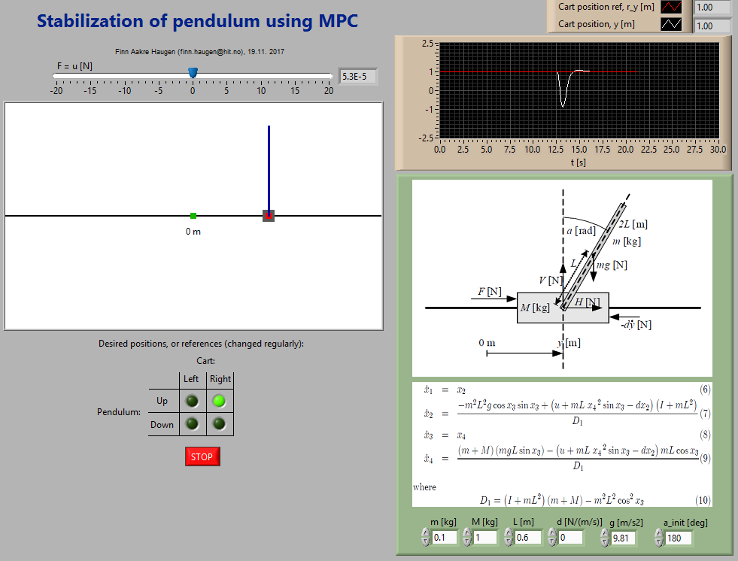
Front panel of the simulator:
Teacher runs simulations.

Slide 14
Application:
MPC temperature control of a simulated air heater

Slide 15
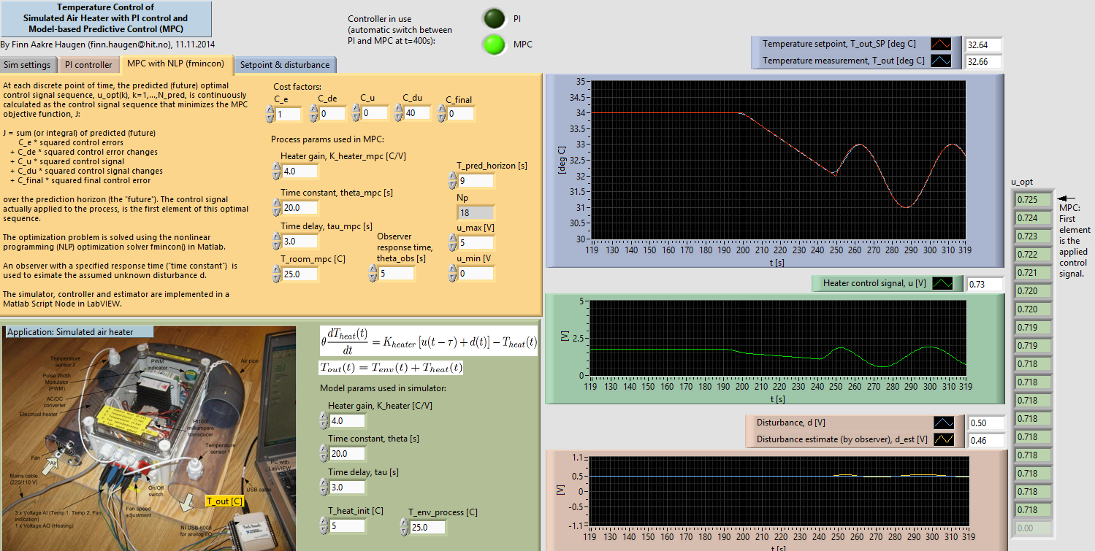
Front panel of the simulator:
Teacher runs simulations.

Slide 16
Application:
MPC for averaging level control of the inlet magazine upstreams the VEAS wrrf (water resource recovery facility),
Slemmestad, Norway

Slide 17
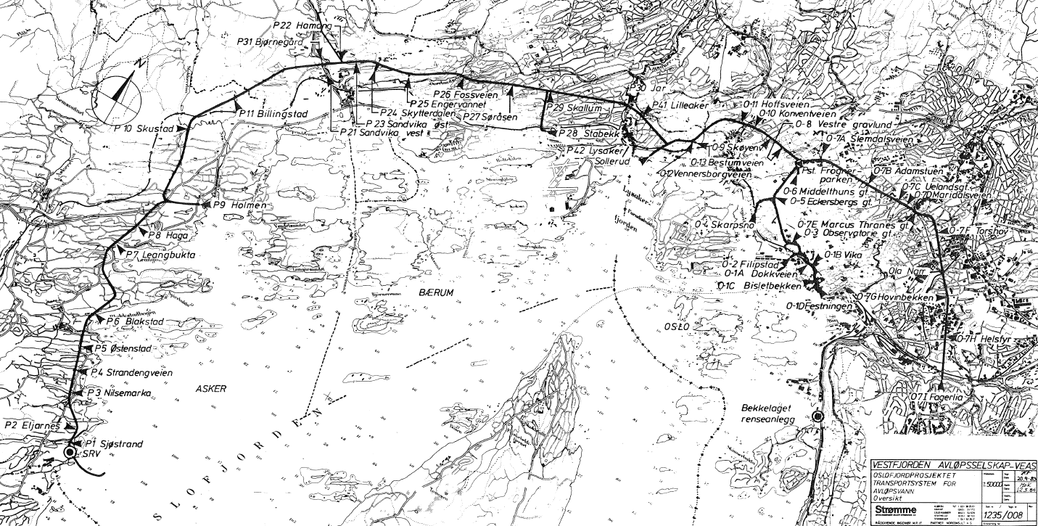
Sewage system of Oslo and surroundings
Oslo
Vækerø
Slemmestad

Slide 18
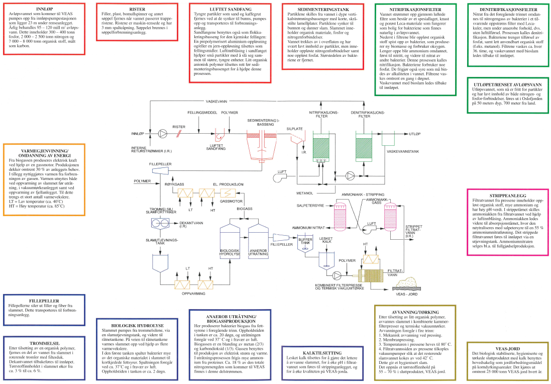
The WWTP in Slemmestad (in the Bjerkås mountain):

Slide 19
Facts about VEAS
VEAS is Norway's largest wastewater treatment plant (WWTP)
Serves approx. 700.000 pe (person equivalents).
Treats 100 – 120 mill m³/y. Average: 3,5 m³/s.
Retention time in the WWTP: 3 – 4 hours.

Slide 20
20
The inlet magazine:
Inflow to WWTP
Tunnel
Inlet basin
Controller

Slide 21
Requirements of level control of inlet basin:
1. Level setpoint: 2.3 m = -12.7 m below sea level (approx.).
2. Level should be below 1.8 and 2.8 m.
3. Pump flow, F_in, constrained between 8000 and 0 L/s.
4. F_in should be as smooth as possible, i.e. d(F_in)/dt should be as close to 0 as possible. Specifically, VEAS wants
d(F_in)/dt <= 20 (L/s)/min.

Slide 22
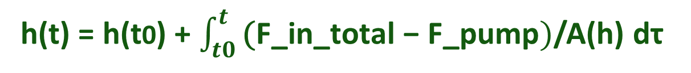
The MPC needs a mathematical model of
the level, h, in the inlet basin:
Material balance:
Rate of change of mass = inflow minus outflow
Mathematically:
rho*A(h)*dh/dt = rho(F_in_total - F_pump)
which, after cancelling rho, gives
the following formula for level h:
h(t) = h(t0) + $\int_{t0}^{t}{\text{(}\text{F}\text{_}\text{in}\text{_}\text{total}\text{ − }\text{F}\text{_}\text{pump})}$/A(h) dτ

Slide 23

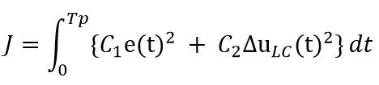
MPC optimization criterion:
der
where u_LC = F_in

Slide 24
Let's look at real results of
three various level control solutions
PI control with original PI settings
PI control with Skogestad (or optimized) PI settings
(cf. previous lecture)
MPC

Slide 25
Computer implementation
PC with LabVIEW and MATLAB:
  LabVIEW for implementation of main program and GUI, and - in case of real experiments - IO (voltages for measurement and control).
  Matlab in Matlab Script Node in LabVIEW for running the MPC based on fmincon() incl. the observer.

Slide 26
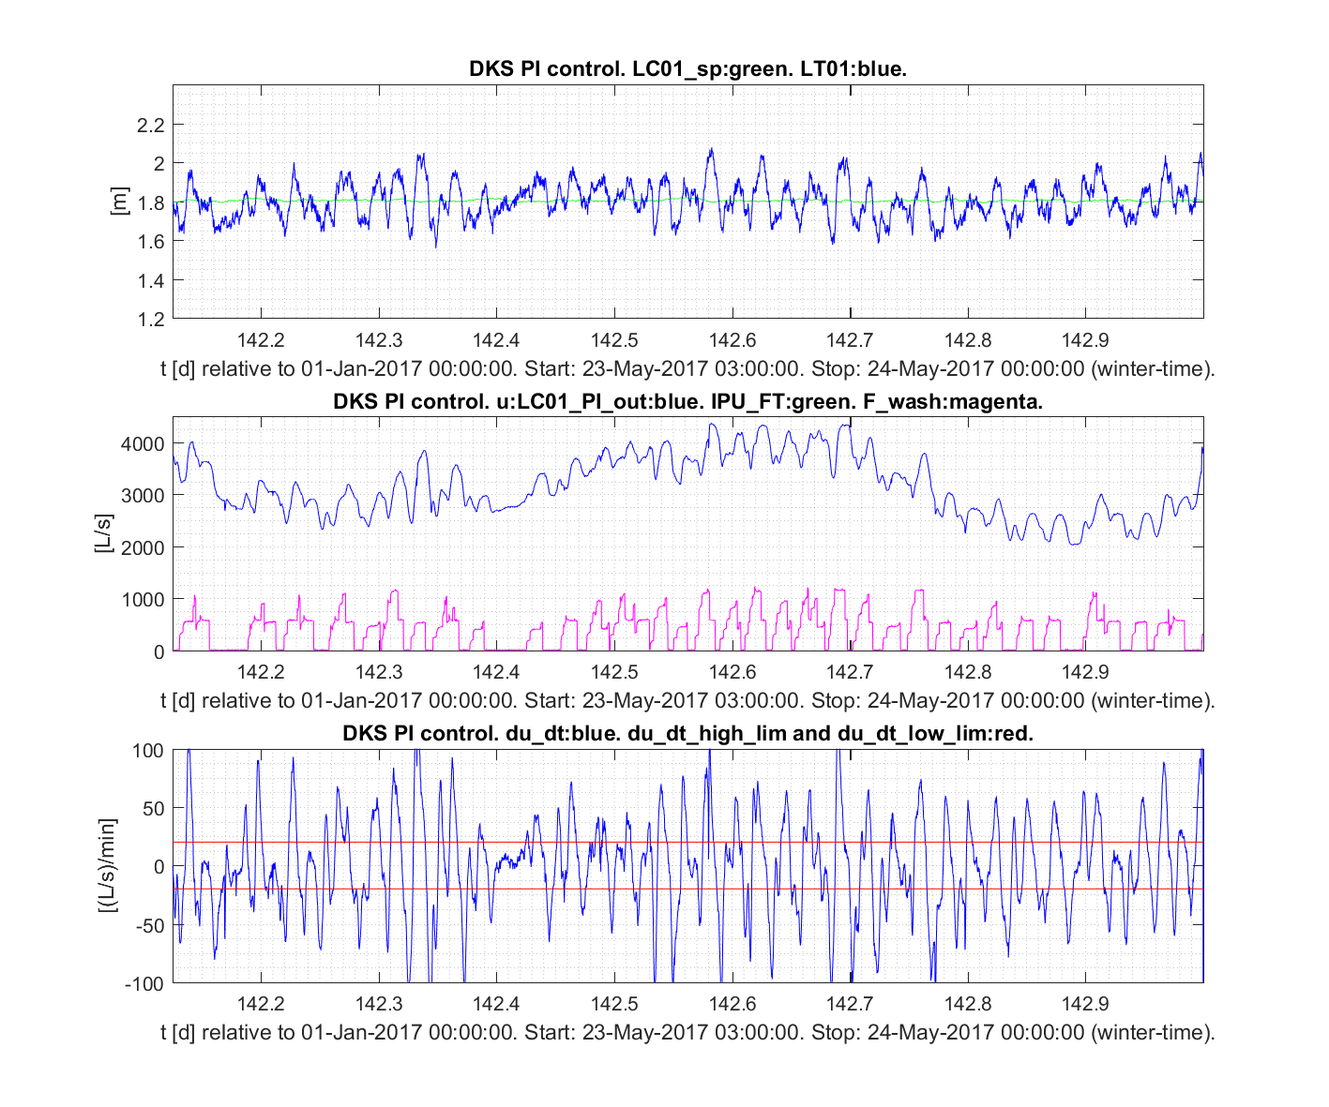
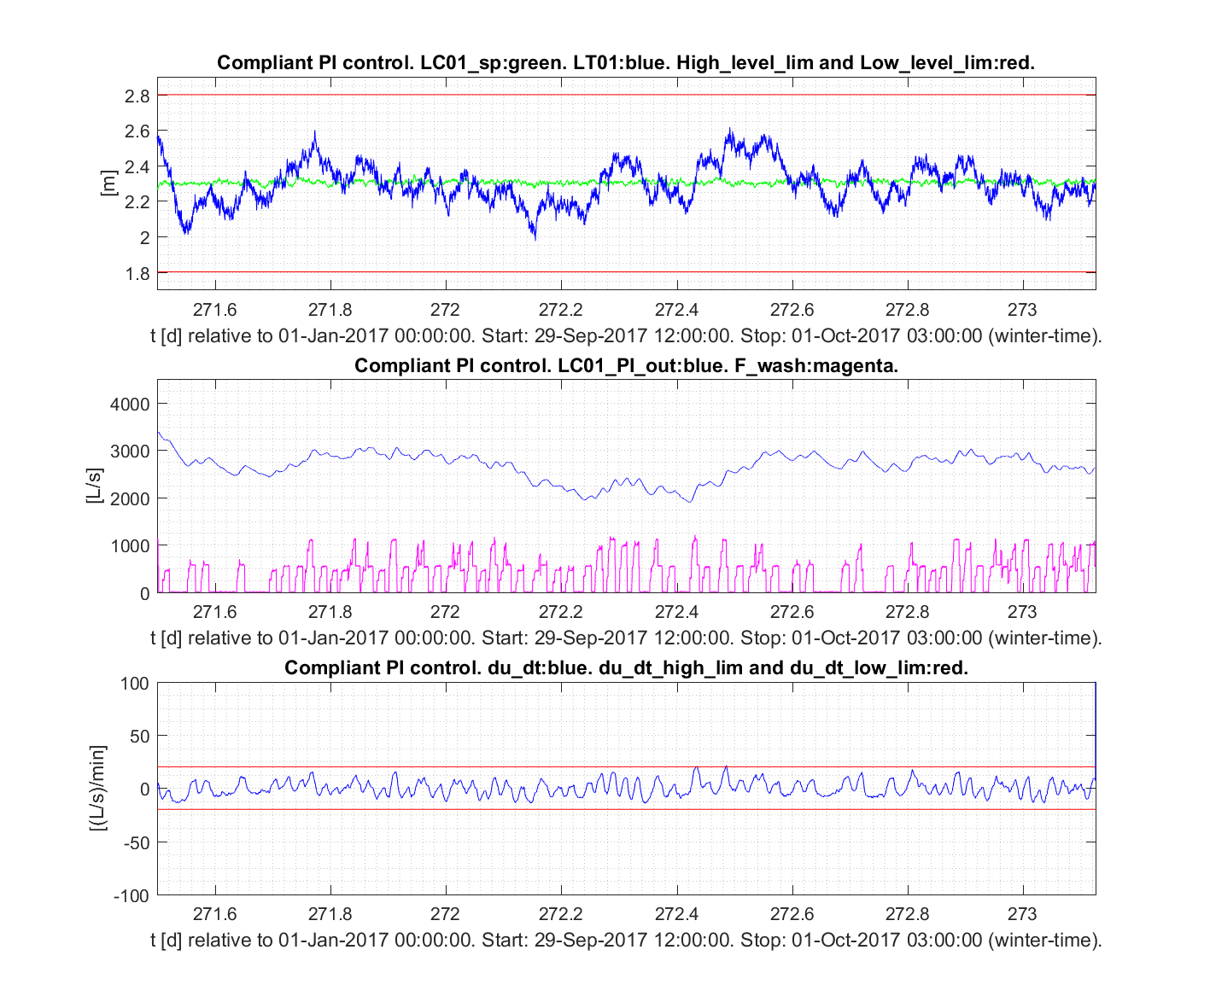
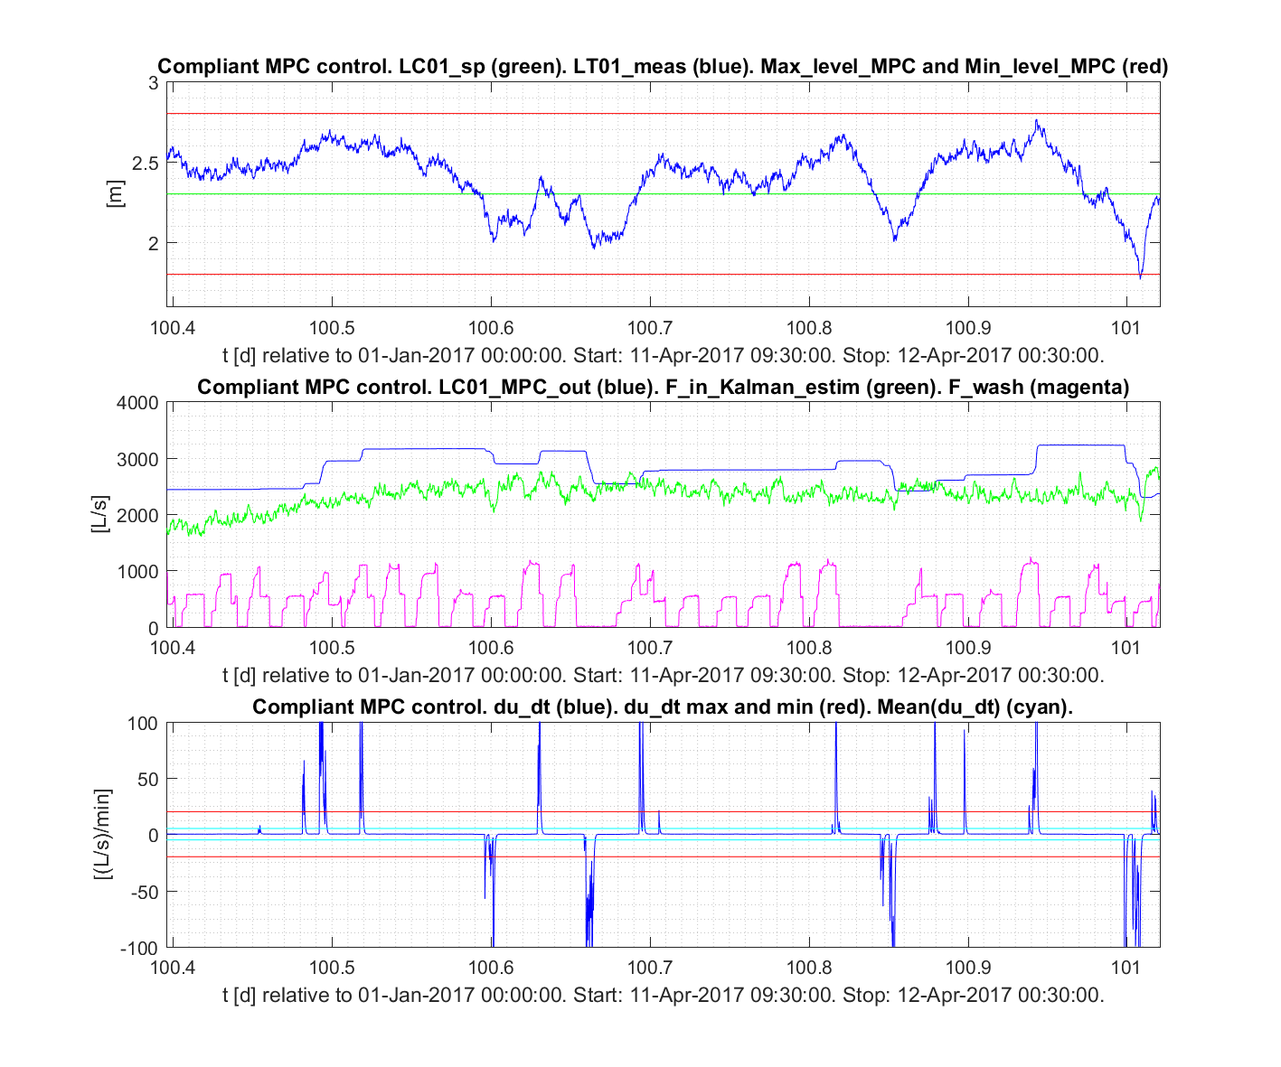
Experimental results on the real plant:
26
Original PI settings
(Kc = 8.0 , Ti = 1000 s)
Skogestad PI settings
(Kc = 3.1 , Ti = 3240 s)
MPC
(preliminary results)
Level
Pump flow
Rate of change
of pump flow
Which is best?

