Slide 1
PID Control
Course PEF3006 Process Control Fall 2017
By Finn Aakre Haugen
(finn.haugen@usn.no)

Slide 2
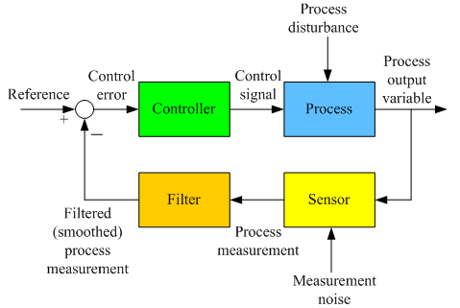
Reviewing the feedback control loop:

Slide 3
The PID controller function
(PID = Proportional + Integral + Derivative)
Control error
Control signal
e
PID
u
P
I
D
Variables (signals):
Parameters (constants):
e – control error = ysp - ym
u – total control signal
u0, or uman, – manual control signal
up – proportional term
ui – integral term
ud – derivative term
Kp – controller gain = 100/PB
Ti – integral time [sec or min]
Td – derivative time [sec or min]

Slide 4
The PID controller function (cont.)
I-term, ui, and therefore total control signal, u, will change (increase or decrease) as long as control error is different from zero, causing the error to eventually become zero (in steady-state).
P- and D-term contributes with speed in control action. D-term can also provide increased stability (damping). Unfortunately, D-term amplifies measurement noise. Therefore, the D-term is quite unpopular, and is often not used.

Slide 5
Measurement filter
Without meas filter:
With meas filter:
Purpose of the filter: To smooth noisy measurement signal, thereby causing the control signal to become smoother.
Which filter to use? A time-constant filter is commonly used.
How to select the time-constant: Trial-and-error. Typical value in industrial control loops: A few seconds (e.g. 2 or 5 sec).

Slide 6
Let’s try:
Level control of wood-chip tank
(where we study the the P-, D-, and I-terms of the control signal - with and without measurement noise.)

