Slide 1
PID controller: Reverse or direct action?
Course PEF3006 Process Control Fall 2017
By Finn Aakre Haugen
(finn.haugen@usn.no)

Slide 2
Some processes requires the PID controller to have Reverse action, while others require Direct action.
If you select wrong, the controller will adjust the control signal in wrong direction (e.g. increase when it should decrease). In other words:
The control system becomes unstable!

Slide 3
How to select between Reverse and Direct?
Assume that the process measurement is equal to the setpoint initially, and that for any reason the process measurement increases to become larger than the setpoint. The sign of the change of the control signal needed to bring the process measurement back to the setpoint determines between Reverse and Direct action:
Select Reverse if controller must decrease control signal (to counteract increased measurement).
Select Direct if controller must increase control signal (to counteract increased measurement).
Easy to remember:
Measurement up – control signal down (”up-down”). Reverse!
Measurement up – control signal up
(”up-up”). Direct!

Slide 4
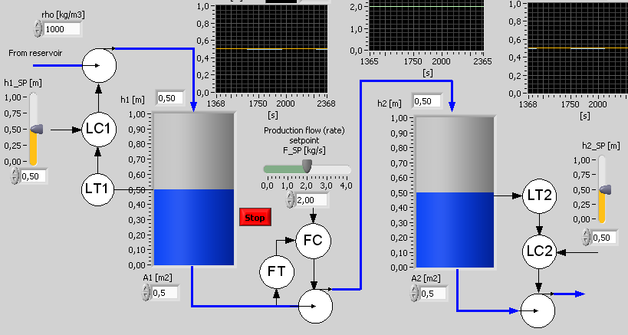
Example: Level control systems
Reverse or direct?
Simulator:
Reverse and direct action
Revers or direct?

Slide 5
On some controllers:
Reverse mode = Heating mode
Direct mode = Cooling mode
Why these somewhat strange terms? Let's think about temperature control systems...

