Slide 1
Ratio control
Course PEF3006 Process Control Fall 2017
By Finn Aakre Haugen
(finn.haugen@usn.no)

Slide 2
Purpose: To maintain a specified ratio of two flows:
F2 = K*F1
2

Slide 3
3
Equivalent but simpler (right):

Slide 4
Ratio control can be part of a product quality and production rate control system:

Slide 5
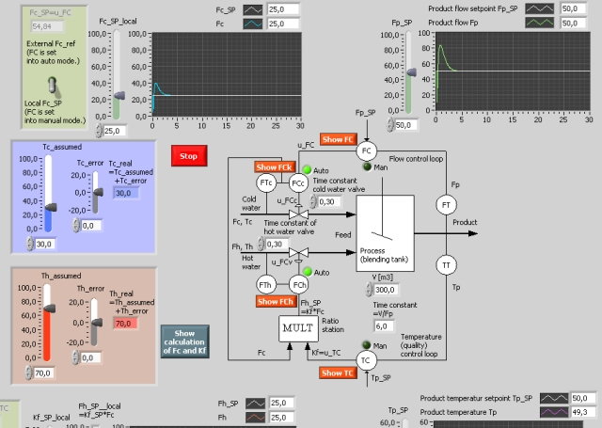
Example: Production of water flow with specified flow rate and temperature
Simulator

