Slide 1

Sensors
PEF3006 Process Control
Fall 2017
By Finn Haugen
(finn.haugen@usn.no)

Slide 2
Current loop

Slide 3
Purpose: Getting V from mA

Slide 4
Where is the sensor in the control loop?
Temperature
Pressure
Level
Flow

Slide 5
Temperature

Slide 6
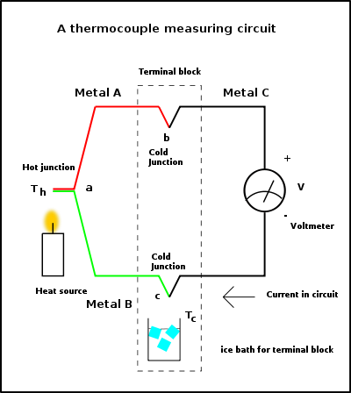
Temperature sensor: Thermocouple (TC)
A thermocouple consists of two conductors of different alloys. Whenever there is a temperature difference between the hot junction (measuring point) and the cold junction there is a voltage difference between the conductors at the cold junction which can be measured (the Seebeck-effekten).
Cold junction temperature is typically room temperature and it is measured with a a thermistor inside the measurement transmitter.
[http://en.wikipedia.org/wiki/Thermocouple]

Slide 7
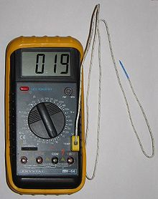
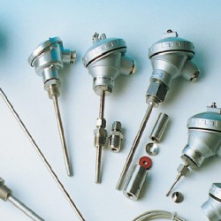
Thermocouples cont.
Different types identified with letter codes: K, E, J, N, etc,
They have different voltage/temperature sensitivity and different environmental properties. Tables can readily be found on the Internet.
Type K is most common:
Cromel + Alumel (both are nickel alloys).
Sensitivity: 41 µV/°C
Measuring range: −200 °C to +1350 °C
[Autek AS]
[Autek AS]

Slide 8
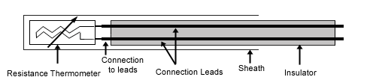
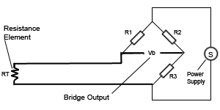
Temperature sensor:
Resistance Temperature Detector (RTD)
Principle: Temperature-dependent resistor with well-defined T/R-relation (temp/resistance).
Common: Pt100 RTDs: Pt is platinum. 100 means that R=100 Ohm at 0 degrees C.
R-value is measured with Wheatstones bridge:
[http://en.wikipedia.org/wiki/Resistance_thermometer]

Slide 9
Select TC or RTD?
Accuracy: RTD is approx. 0.2 deg C. TC is approx. 2 deg C.
In general, is recommended in range -200 - 500 deg C. Above 500 deg C RTD can not be used.
[http://en.wikipedia.org/wiki/Resistance_thermometer]

Slide 10
Pressure

Slide 11
Pressure sensor: dP-cell
dP = differential pressure
dP-cells are actually very applicable:
Pressure
Level
Flow

Slide 12
dP-cell cont.
To electronics
PH
PL
Pressure High
Pressure Low
Pressure is directly applied to the isolating diaphragms (2). Pressure is transmitted to sensing diaphragm through filling fluid (3). Whenever there is difference between PL and PH, the sensing diaphragm (1) , which is a capacitor plate, moves relative to fixed metallized plates (4). The sensing diaphragm (1) deflection results in capacitance variations between the moving and fixed plates. The capacitance variance is detected by electronics.
[Smar Pressure Transmitter.
LD300 Series. Autek AS.]

Slide 13
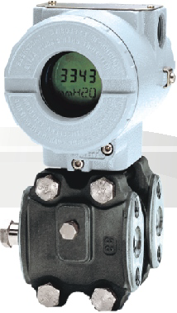
dP-cell cont.
Transmitter
Transducer
[Smar Pressure Transmitter.
LD300 Series. Autek AS.]

Slide 14
dP-cell cont.
Application: Boiler control (valve is actuator).
3 dP-cells are used!
[Smar Pressure Transmitter. LD300 Series. Autek AS.]

Slide 15
Level

Slide 16
Level sensor: Ultra sound
Sound pulses are sent to liquid surface. Refection time indicates level.
[Microflex. Autek AS.]

Slide 17
Ultrasound level sensor cont.
Characteristics:
[Microflex. Autek AS.]

Slide 18
Level measurement with dP-cell

Slide 19
Flow

Slide 20
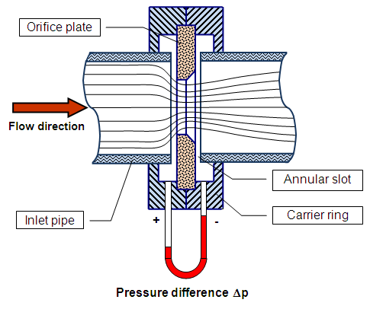

Flow measurement with dP-cell
From Bernoulli's Law flow and pressure drop across the orifice (measured with a dP-cell) is related as:
[http://en.wikipedia.org/wiki/Flow_meter]

Slide 21
Coriolis
Large measurement ranges and high accuracy, e.g.:
0 - 2,2 tons/h with accuracy of 0.1% of measurement span.
[Heinrichs TMU. Flow-teknikk AS]

Slide 22
Principle of Coriolis sensor:
Density
Mass flow

Slide 23
Gas flow sensor: Thermal sensor
[Bronkhorst. Flow-teknikk AS]

Slide 24

Thermal gas flow sensor cont.:
[Bronkhorst. Flow-teknikk AS]

Slide 25
Magnetic liquid flow sensor
Induced voltage is proportional to flow velocity, and, therefore, to volumetric flow.

Slide 26
Doppler (with ultra sound)
Flow is a function of difference between "red" and "blue" travel time.

Slide 27
Spektroscopic (IR) sensor for gas consentration

