Slide 1
Split-range control
Course PEF3006 Process Control Fall 2017
By Finn Aakre Haugen
(finn.haugen@usn.no)

Slide 2
2
When you control the speed of your limousine:
You have two actuators: The throttle and the break.
Would you use both the throttle and the break, simultaneously, to adjust the speed, or would you use one of them at a time, i.e. use the actuators in a coordinated manner?
This is what split-range control is about - namely, coordinated use of several actuators.

Slide 3
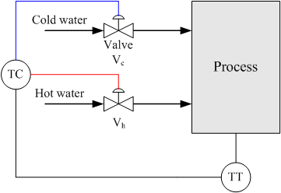
3
Typically: One controller (TC) manipulates two actuators:
Example:

Slide 4
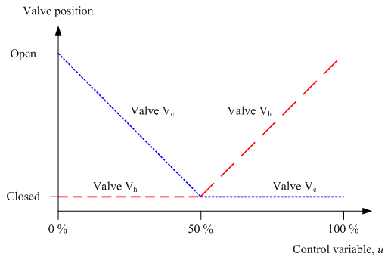
4
Split of control signal(s) in the example:

