Slide 1
Cascade control
Course: Process Control, NMBU
Dec 2017 - April 2018
By Finn Aakre Haugen, PhD, TechTeach
(finnhaugen@hotmail.com)

Slide 2
Benefit of cascade control
(comparing with ordinary single loop control):
Faster (more effective) compensation of process disturbances.

Slide 3
Review:
Single-loop control system
3

Slide 4
4
Improved structure with faster (more effective)
disturbance compensation:
Cascade control system

Slide 5
Interpretation:
With cascade control, the original actuator
is substituted by a "new" well-behaving" actuator:

Slide 6
Controller tuning:
First, tune the secondary controller (with the primary controller in Manual mode).
Then, tune the primary controller (with the secondary controller in Auto mode).

Slide 7
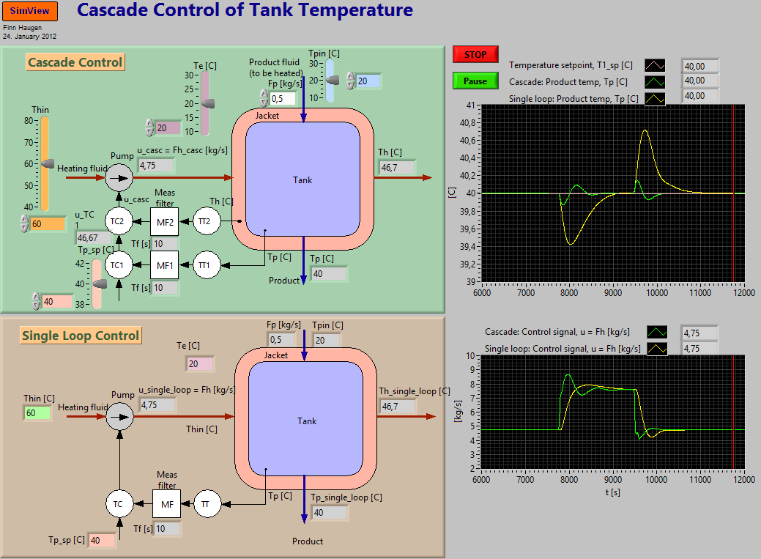
  Example 1: Cascade control of temperature in a vessel
7
Simulator (unzip all the files, and then run the exefile).

Slide 8
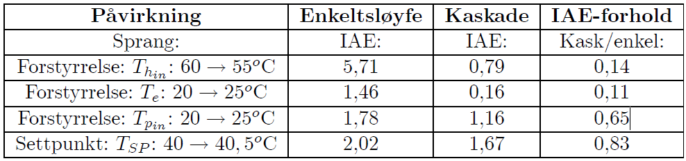
  Example 1 cont.:
  Comparing performance indexes IAE (Integral of Absolute value of control Error):
  Excitation
  Single-loop
  Cascade
  Their ratio
  (Sprang = step)
  (Forstyrrelse = disturbance)
  Which of the control structures is the best?

Slide 9
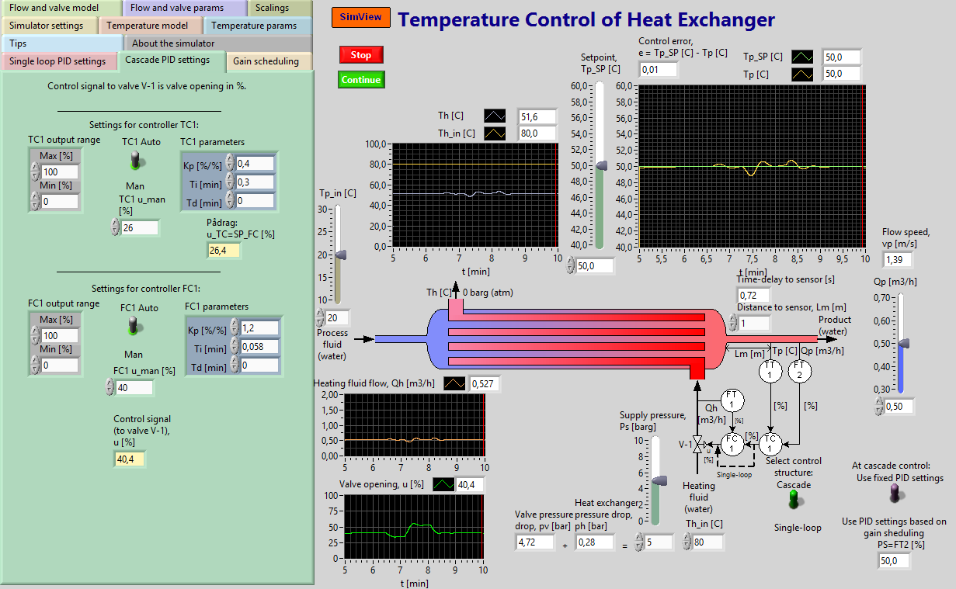
  Example 2: Cascade control of heat exchanger
  Simulator

