Slide 1
Controllers
Course: Process Control, NMBU
Dec 2017 - April 2018
By Finn Aakre Haugen, PhD, TechTeach
(finnhaugen@hotmail.com)

Slide 2
Where is the controller in the control loop?

Slide 3
Process Controller
(ECA600, ABB)

Slide 4
Process Controller cont.
Backplane of ECA600:
AO = Analog Output
(from controller)
= Control signal
to the actuator
AO signal ranges:
4 – 20 mA (most popular)
or 0 – 5 V or 0 – 10 V
AI = Analog Input
(to controller)
= Measurement signal
from the sensor
AI signal ranges:
4 – 20 mA (most popular)
or 0 – 5 V or 0 – 10 V
Digital communication

Slide 5
Process controller cont.
From User’s Manual
(Compact FieldPoint, National Instruments)
Basic
features

Slide 6
Another example:
ABB CM50

Slide 7
CM50 comes with several templates of
control structures.
Example (cascade + feedforward control):

Slide 8
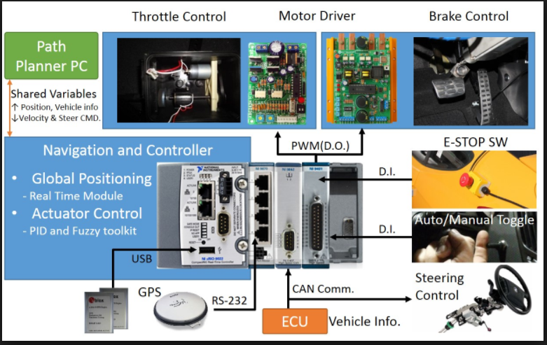
Programmable Automation Controller (PAC)
CompactRIO, National Instruments:
"The CompactRIO platform features a range of embedded controllers with two processing targets: (1) a real-time processor for communication and signal processing and (2) a user-programmable FPGA to implement high-speed control and custom timing and triggering directly in hardware. Eliminate the need for separate subsystems by connecting directly to sensors, displays, cameras, and motors and take advantage of powerful development and run-time software." (National Instruments)

Slide 9
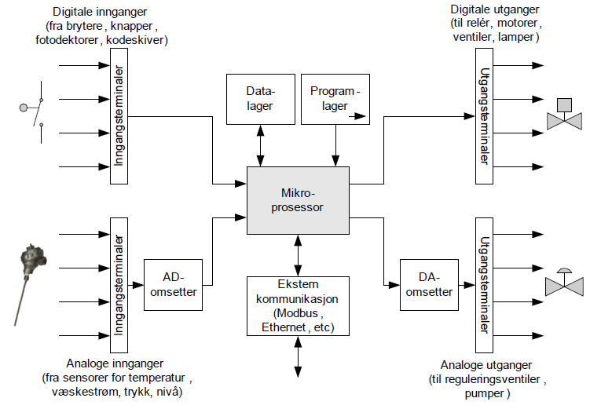
Principal components of PLC and PAC
(in Norwegian, but assumed understandable)

Slide 10
Principal structure of SCADA (Supervisory control and data aquisition) and of DCS (distributed control systems) (here: Siemens PCS7)

Slide 11
Simple, "home-made", PC-based monitoring and control system for non-critical experimental work
(in Norwegian, but assumed understandable)

