Slide 1
Skogestad method of PID controller tuning
Course: Process Control, NMBU
Dec 2017 - April 2018
By Finn Aakre Haugen, PhD, TechTeach
(finnhaugen@hotmail.com)

Slide 2
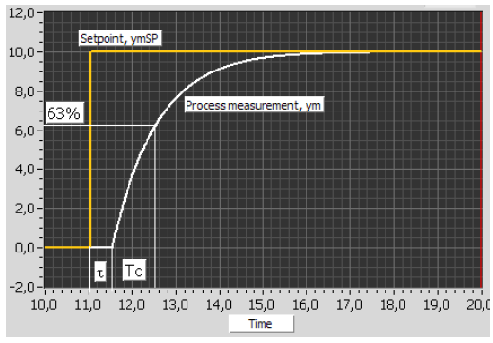
Skogestad’s method is a model-based method, but the model parameters may stem from a
simple step-response test on the process.
You must specify the time-constant Tc of the closed-loop system (illustrated below with setpoint step response):
tau is
process
time-delay

Slide 3

Skogestad’s PI-tuning for a
”integrator with time-delay” process
Find model parameters K and tau from process step response
(or from a mathematical process model, if you have one):
(If time-delay is disregarded)
PI controller settings:
Kp = 1/[Ki*(Tc + tau)] = 1/(2*Ki*tau) if Tc = tau.
Ti = 2(Tc + tau) = 4*tau if Tc = tau.
Skogestad uses 4 in stead of 2 in the Ti formula, but you get faster disturbance compensation with 2.
If you do not know how to specify Tc, Skogestad suggests Tc = tau.
But if the process has negligible tau, you can not set Tc = tau. Then you must select Tc by yourself.

Slide 5
5
Let’s try
Temperature control of liquid tank

