Slide 1
The Ziegler-Nichols' method of PID controller tuning
Course: Process Control, NMBU
Dec 2017 - April 2018
By Finn Aakre Haugen, PhD, TechTeach
(finnhaugen@hotmail.com)

Slide 2
Aim of tuning:
As fast control as possible,
but with
acceptable stability, i.e. ¼ decay ratio
2
Disturbance step:
A2/A1 = 1/4
Response in controlled
process output:

Slide 3
3
Experimental setup in Ziegler-Nichols’ method:

Slide 4
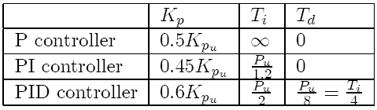
Tuning procedure of Ziegler-Nichols’ method:
4
With controller in manual mode: Bring the process to the specified
operating point by manually adjusting the control variable
until the process variable is approx. equal to setpoint.
Turn PID controller into P controller with gain Kp = 0. (Ti = very large. Td = 0.)
Set the controller to automatic mode.
Increase gain Kp (you may start with Kp = 1) until there are steady oscillations
in the loop due to a small setpoint step.
This controller gain value is the ultimate gain, Kpu.
Read off the period, Pu, of the oscillations.
Calculate controller parameters from the Z-N formulas:
Recommending:
"Relaxed ZN PI-tuning"
(cf. article by FH og B. Lie):
Kp = 0,32*Kpu og Ti = Pu.

Slide 5
5
  Let’s try Z-N tuning of a PI controller on this simulator:
Level control of wood-chip tank

Slide 6
Repeated Ziegler-Nichols
(for PI contollers)
Assume that the PI settings are Kp0 and Ti0, and that the control system - unfortunately - has poor stability with these settings showing poorly damped oscillations with period Pu.
Improved PI setting can be obtained by applying ZN tuning assuming that these oscillations are true ZN oscillations:
Kp = 0.45Kp0
Ti = Pu/1.2

Slide 7
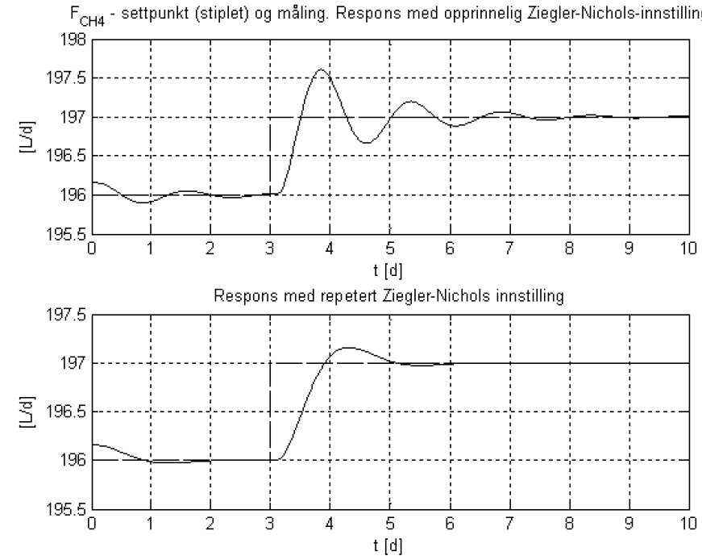
Ex.: PI controller in biogas control system
Original ZN
Repeated ZN

Slide 8
8
Auto-tuning
(automatic PID tuning)

Slide 9
Example of auto-tuner: The Relay or On/Off tuner (by Åström and Hägglund). Sustained oscillations come automatically in control loop. From the amplitude and the period of these oscillations proper PID controller parameters are calculated by an algorithm in the controller.
Amplitude A
Amplitude Y
Period Pu
In Ziegler-Nichols’:
Use Pu and
Kpu = 4*A/(pi*Y).

Slide 10
10
  Example:
  Relay-tuning of a PI temperature controller:
Temperature Control of Liquid Tank

