Slide 1
Process dynamics
Course: Process Control, NMBU
Dec 2017 - April 2018
By Finn Aakre Haugen, PhD, TechTeach
(finnhaugen@hotmail.com)

Slide 2
Terms
Gain
Time-constant
Integrator (or accumulator)
Time-delay
Why are these terms important?
To give names to dynamic properties of physical systems
To make you identify and understand dynamic properties
Can be used in controller tuning - using model-based methods (e.g. Skogestad’s method - to be described later in this course)

Slide 3



Definition of time-constant systems
Time-constant systems can be represented with the following differential equation, where u is the system input and y is the output:
T is the time-constant. K is the gain.
From this differential equation we can calculate the following transfer function from input u to output y:
This transfer function is the standard transfer function of a time-constant system.

Slide 4

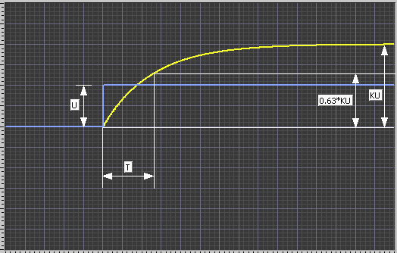
K and T in the step response
By applying a step at the input of the system, you can read off K and T from
the step response at the output.
Step response:
Input step
ys
U
K = Output / Input
= ys/U = delta y / delta u
(at steady-state!)
T is the 63% response time
t

Slide 5
Simulator:
Time-constant

Slide 6
Example: Liquid tank with heating
Simulator:
Heated tank
(Mathematical model on next slide.)

Slide 7








Mathematical model of heated tank
Energy balance:
From this differential equation we can derive the following transfer functions, assuming neglected heat transfer (Uh=0) (Delta indicates “deviation from operating point”):
Time-constant and gains:
If the heat transfer is neglected (Uh=0), the time-constant is simply mass divided by mass flow:
Let's see if m/F is equal to the "experimental" time-constant as read off on the simulator: Heated tank

Slide 8



Definition of integrator systems
Integrator systems can be represented with the following integral equation, where u is the system input and y is the output:
Ki is the integrator gain.
An integrator can be termed accumulator as it accumulates the inputs:
y(tk) = Ki * [u(t0) + u(t1) + … + u(t0)]*dT
The above integral equation corresponds to this diff. equation:
The transfer function from input to output is

Slide 9

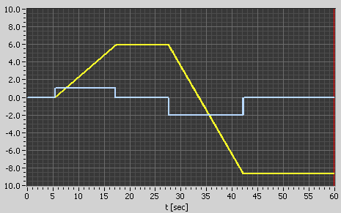
Step response of an integrator
The step response is a ramp:
Input (step)
Output (ramp)

Slide 10
  Simulators:
Integrator
Liquid tank
(Mathematical model on next slide.)

Slide 11
Mathematical model of liquid tank
Mass balance
(assume valve is closed):
A * dh/dt = qin – qout = qin – Kp*up (pump)
dh/dt = (1/A) * (qin – qout) = (1/A) * (qin –Kp*up)
which is on the standard form of an integrator
(except in our example we have two “input” signals, qin and qout)

Slide 12
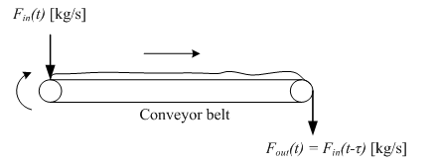
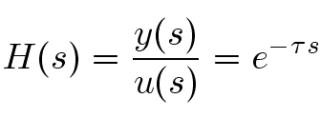
Time-delay
(or transport-delay, dead-time)
Example: Conveyor belt
(Outflow is equal to time-delayed inflow.)
Transfer function:

Slide 13
  Simulator:
Time-delay

Slide 14
Very hard questions:
1.
2.

Slide 15
Combined dynamics
Example: Wood-chip tank
Level control of wood-chip tank
How will you characterize
the dynamics of this system?

