Slide 1
Feedforward Control
Course: Process Control, NMBU
Dec 2017 - April 2018
By Finn Aakre Haugen, PhD, TechTeach
(finnhaugen@hotmail.com)

Slide 2
Why?
Faster disturbance compensation
and/or
Faster setpoint tracking (important only with time-varying setpoint)
How?
Connecting disturbance measurement signal directly to the actuator (the control signal)
What is needed?
Measurement of disturbance(s)
and
Process knowledge
in the form of some mathematical model

Slide 3
Control system with both feedforward and feedback:

Slide 4
Example 1:
Feedforward control in a temperature control system
  (We will run a simulator of this example.)

Slide 5


Example 1 cont.:
How to derive the feedforward controller:
(1) Process modelling: Energy balance:
(2) The feedforward controller is obtained by
solving for the control variable, and
substituting the process variable by its setpoint:
Can it be implemented?
Find out by inspecting the right-hand side!
All terms must have known values.
Which sensors are needed?

Slide 6
  Example 1 cont.:
  Simulator:
  Feedforward control in temperature control system

Slide 7
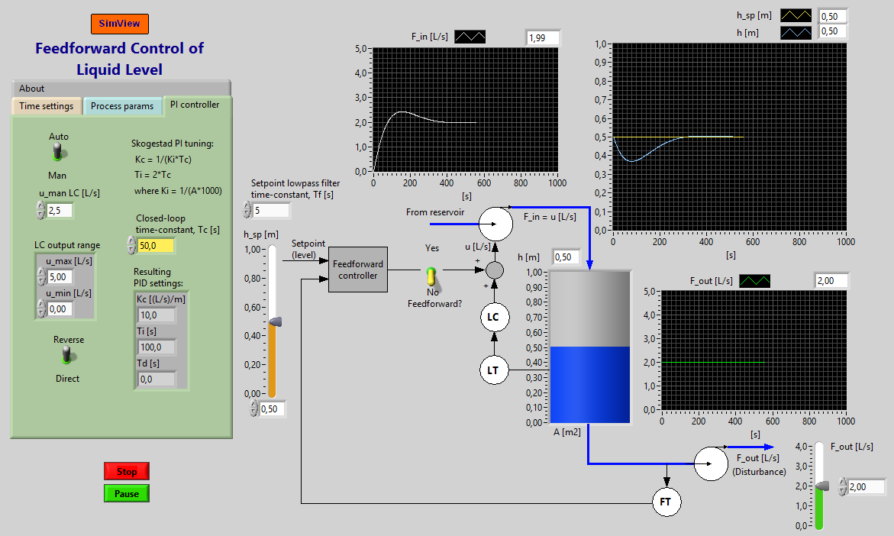
Example 2: Feedforward in level control system
Simulator
Let's derive the feedforward controller (it is quite easy).

Slide 8
8
Experimental
feedforward

Slide 9
Structure of control system:
9

Slide 10
10
Relation between disturbance measurement and
steady-state control signal (with PID controller):

Slide 11
Example: Temperature control
11

Slide 12
Without feedforward (only feedback):
12

Slide 13
With feedforward (and feedback)
13
Improvement?

Slide 14
Example 2: Feedforward from inlet temperatur (Tp_inn)
in temp. control of heat ex.
  Simulator

