Slide 1
Filtering of measurement signals
Course: Process Control, NMBU
Dec 2017 - April 2018
By Finn Aakre Haugen, PhD, TechTeach
(finnhaugen@hotmail.com)

Slide 2
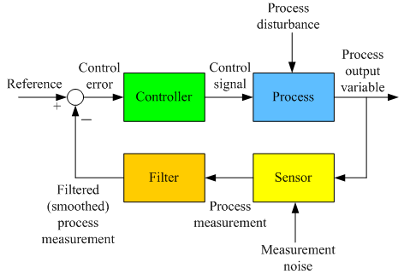
Control loop with measurement filter:
Without meas filter:
With meas filter:
The purpose of the filter: To smooth the noisy measurement signal, to make the control signal less noisy.
Which filtering function? Time-constant is the most common, by moving average is also used.

Slide 3
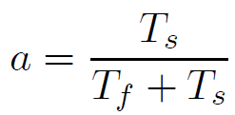
Filtering functions:
1. Time-constant filter algorithm:
Simulator

Slide 4
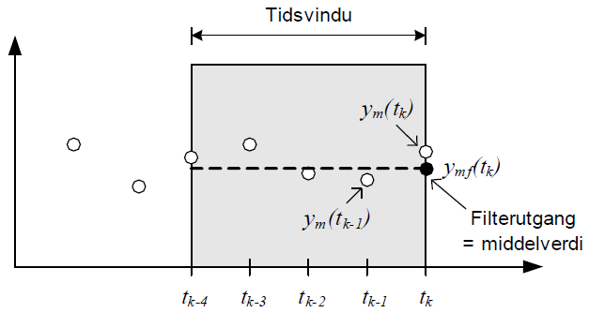
2. Moving average filter (example: 4th order filter):

Slide 5
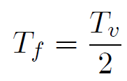
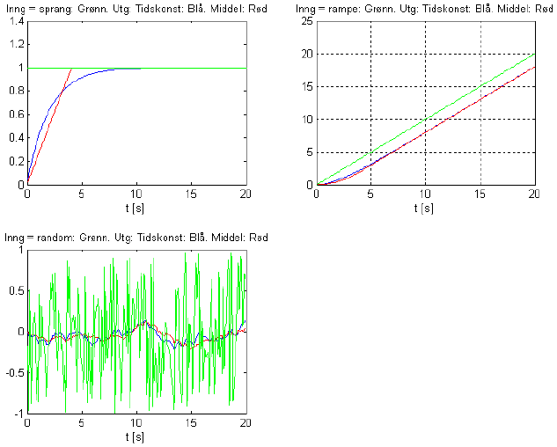
These two filters behave quite similar if:
Tf = 2 sec. Tv = 4 sec.
Ts = 0.1 sec.

