Slide 1
Introduction to process control
Course: Process Control, NMBU
Dec 2017 - April 2018
By Finn Aakre Haugen, PhD, TechTeach
(finnhaugen@hotmail.com)

Slide 2
Software requirement for running SimView simulators
  Most of the lectures and exercises of this course include running simulators. These simulators have been developed in LabVIEW. Here are the requirements for the simulators to run.

Slide 3
What is
automatic control?

Slide 4
  Automatic control is making process variables stay sufficiently near their setpoints (references)
  - automatically (i.e. without manual operations):

Slide 5
Common process variables
to be controlled to follow setpoints:
Temperature (heat exchanger, reactor, room)
Pressure (reactor, oil/water/gas-separator)
Flow (gas or liquid flows in pipe)
Level (tank)
Position (ship, robot)
Rotational speed (motor)

Slide 6
Areas where automatic control
can make large benefits:
Product quality
Product economy
Safety
Environment protection
Comfort
Feasibility
Automation

Slide 7
The principle of feedback control

Slide 8
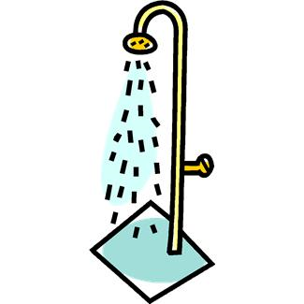
Think about how you you act
while you are controlling the temperature of the water in the shower to make the temperature become equal to the desired temperature (aka. the temperature setpoint or reference), even under disturbances like reduced availability of hot water and variations of air temperature in the room.

Slide 9
I guess you act like this (text on next slide):

Slide 10
You manipulate the actuator (tap) until the difference between the temperature setpoint and the temperature measurement is sufficiently small.
This is error-driven control!
It is the fundamental control principle in technical, industrial, biological, social system.
More common terminology than error-driven control:
Feedback control
Closed loop control
Automatic control

Slide 11
Temperature control system implemented with industrial components:

Slide 12
Piping & Instrumentation Diagram (P&ID) for
the temperature control system:
(TT = Temperature Transmitter)
(TC = Temperature Controller)

Slide 13
So, how does the controller act?
It manipulates the process variable by changing the control signal to the actuator
until the control error has become zero. So, it continually improves, until the aim is reached:
Zero error.
In practice it is the mean error which will be zero as there will always be some disturbances making the error vary somewhat, see the figure below.

Slide 14
Example of industrial feedback control system:
Level control of wood chip tank
(Process & Instrumentation Diagram - P&ID)

Slide 15
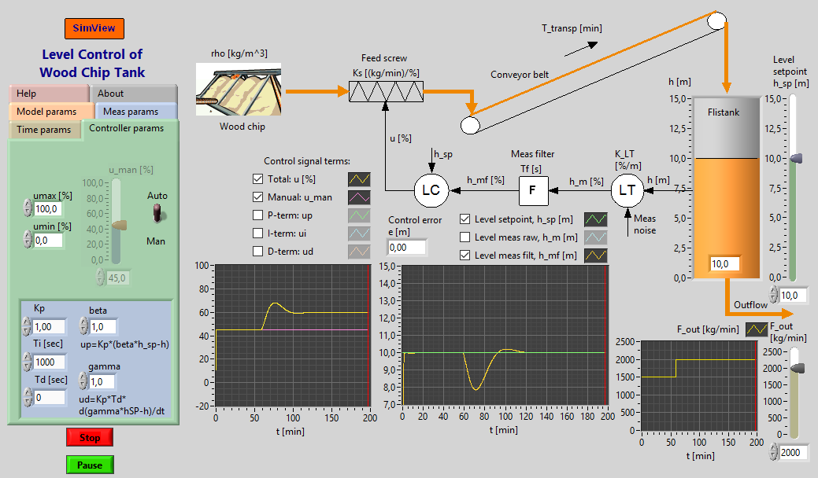
Simulator
(Run the exe-file in the link.)

Slide 16
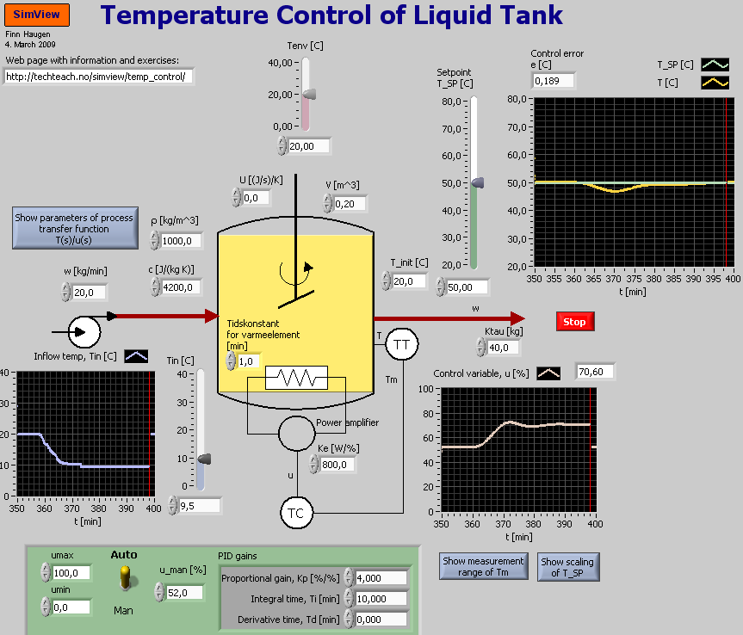
  Another example:
Simulator

Slide 17
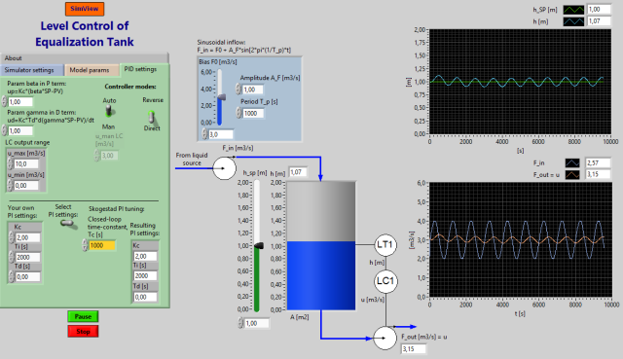
A third example (see comment on next slide):
Simulator

Slide 18
The third example (see previus slide) resembles the inlet equalization basin upstreams VEAS wrrf:

Slide 19
  Symbols in
  Piping & Instrumentation Diagrams (P&IDs)

Slide 20
Standards for P&IDs:
ISO 3511-1
ISA S5.1

Slide 21
Letter codes (for P&IDs):

Slide 22
Instrumentation symbols:

Slide 23
Process fluid and signals:

Slide 24
Valves:

Slide 25
Tanks:

Slide 26
Heat exchanger:

Slide 27
Pumps:

Slide 28
  Block diagrams of control systems

Slide 29
A simplified block diagram showing the most essential parts:
We will relate this block diagram to the level control system of the wood-chip tank.

