Slide 1
On-Off control
Course: Process Control, NMBU
Dec 2017 - April 2018
By Finn Aakre Haugen, PhD, TechTeach
(finnhaugen@hotmail.com)

Slide 2
2
  On-off controller function:
u = umax when e >= 0.
u = umin when e < 0.
I think that the On-off controller is the simplest
error-based (or: feedback-based) controller that exists.

Slide 3
3
  On-off controller with dead-zone:
De is the dead-band.
Purpose is to avoid
control signal changes
caused by measurement noise.

Slide 4
4
  Comparison with P-controller:
P-controller:
u = Kp*e + u0
Kp
u0
On-off controller

Slide 5
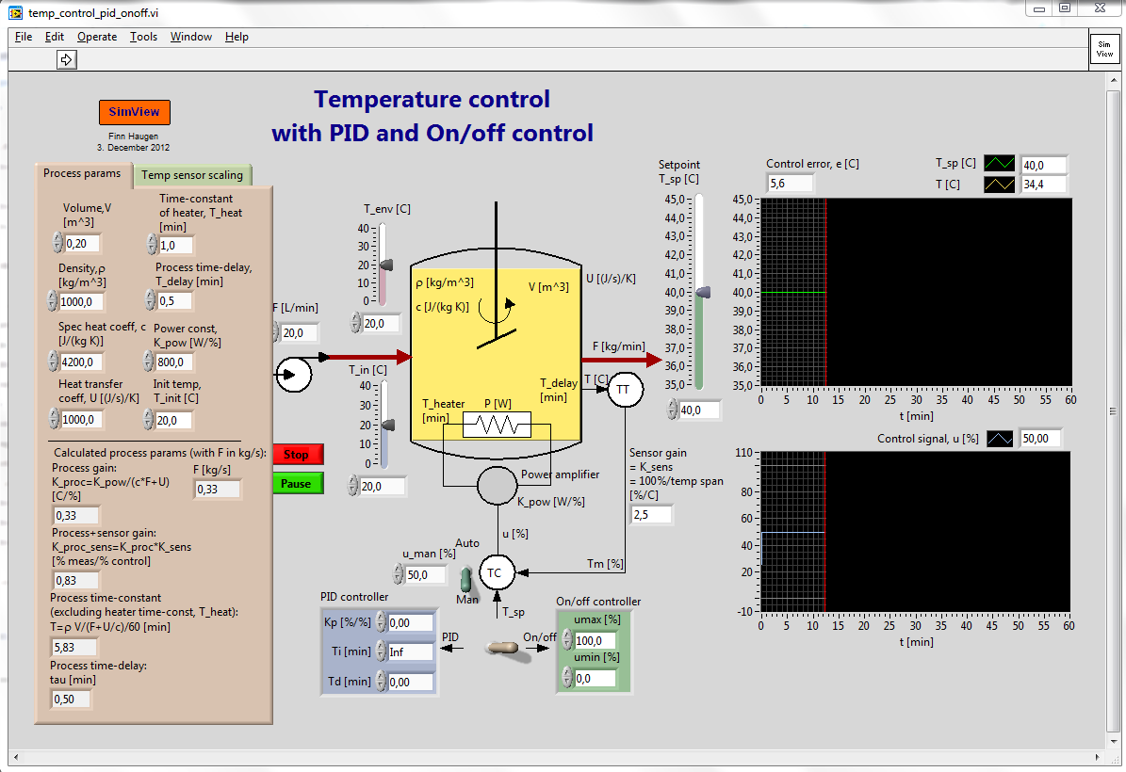
  Example:
  Temperature control with PID and On-off controller

Slide 6
  Simulated responses:
  Process variable (temperature) varies around the setpoint, which is fine.
  But is the average control error zero (as we normally would like to obtain)?
  Process variable (temperature) oscillates!
  On-off pattern of control signal can cause problems with mechanical actuators, but not with electrical actuators.

