Slide 1
PID Control
Course: Process Control, NMBU
Dec 2017 - April 2018
By Finn Aakre Haugen, PhD, TechTeach
(finnhaugen@hotmail.com)

Slide 2
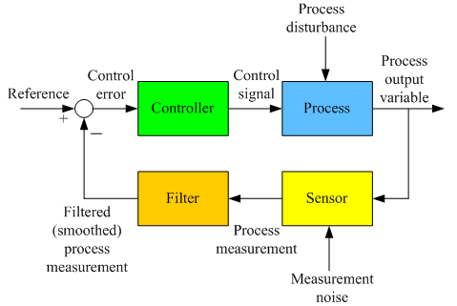
Reviewing the feedback control loop:

Slide 3
The PID controller function
(PID = Proportional + Integral + Derivative)
Control error
Control signal
e
PID
u
P
I
D
Variables (signals):
Parameters (constants):
e – control error = ysp - ym
u – total control signal
u0, or uman, – manual control signal
up – proportional term
ui – integral term
ud – derivative term
Kp – controller gain = 100/PB
Ti – integral time [sec or min]
Td – derivative time [sec or min]

Slide 4
The PID controller function (cont.)
I-term, ui, and therefore total control signal, u, will change (increase or decrease) as long as control error is different from zero, causing the error to eventually become zero (in steady-state).
P- and D-term contributes with speed in control action. D-term can also provide increased stability (damping). Unfortunately, D-term amplifies measurement noise. Therefore, the D-term is quite unpopular, and is often not used.

Slide 5
Discrete-time (computer-based) PID control loop:
(Hoping that the block diagram is understandable despite the Norwegian text.)

Slide 6
Discrete-time PID controller
Introducing simplifyes notation: e(k) = e(tk) og u(k) = u(tk)
PID
u(k) = uman + up(k) + ui(k) + ud(k)
e(k)
P
I
D
u(k) is calculated by the PID algorithm each time step, Ts. (A typical Ts in process controllers is 0.1 s.)
The P, I, and D terms can be calculated as shown on the next slide.

Slide 7
Discrete-time PID algorithm based on discrete-time version of the continuous-time PID function:
P term is proportional with the current control error:
P:
up(k) = Kp*e(k)
The term alone can not give zero error (in steady state) since there must be a error different from zero in order for any compensation to take place. So, there will be some compensation, but not big enough to give zero error.
I term is prop. to the sum of all sampled errors, i.e. accumulated error:
I:
ui(k) = (Kp/Ti)*Ts*[e(1)+…+e(k-1)+e(k)]
= ui(k-1) + (Kp/Ti)*Ts*e(k)
The second row is an alternative, practical implementation of the I term since the additions of old errors are avoided.
The I term ensures zero steady-state error because the I term - and therefore the total control signal (u) - is adjusted whenever the control error is different from zero. So, the controller will keep on improving.
Ideally, the D term increases control speed and stability. Howerver, the D term unfortunately is very sensitive to measurement noise, causing the control signal to become noisy. Therefore, often the d term is not used (Td = 0).
D term is prop. to the rate of change of the control error:
D:
ud(k) = Kp*Td*[e(k)-e(k-1)]/Ts

Slide 8
Measurement filter
Without meas filter:
With meas filter:
Purpose of the filter: To smooth noisy measurement signal, thereby causing the control signal to become smoother.
Which filter to use? A time-constant filter is commonly used.
How to select the time-constant: Trial-and-error. Typical value in industrial control loops: A few seconds (e.g. 2 or 5 sec).

Slide 9
Let’s try:
Level control of wood-chip tank
(where we study the the P-, D-, and I-terms of the control signal - with and without measurement noise.)

