Slide 1
Ratio control
Course: Process Control, NMBU
Dec 2017 - April 2018
By Finn Aakre Haugen, PhD, TechTeach
(finnhaugen@hotmail.com)

Slide 2
Purpose: To maintain a specified ratio of two flows:
F2 = K*F1
2

Slide 3
3
Equivalent
but simpler (right):

Slide 4
Ratio control can be part of a product quality and production rate control system:

Slide 5
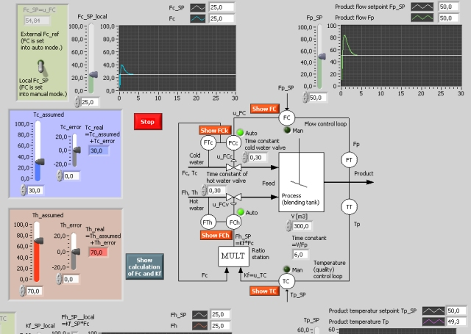
Example: Production of water flow with
specified flow rate and temperature
Simulator

