Slide 1
Sequential control
Course: Process Control, NMBU
Dec 2017 - April 2018
By Finn Aakre Haugen, PhD, TechTeach
(finnhaugen@hotmail.com)

Slide 2
Sequential control with Sequential Function Chart (SFC)
Three basic elements of an SFC:
Steps (states)
Actions
Transitions
(SFC is standardized in IEC 61131-3.)

Slide 3
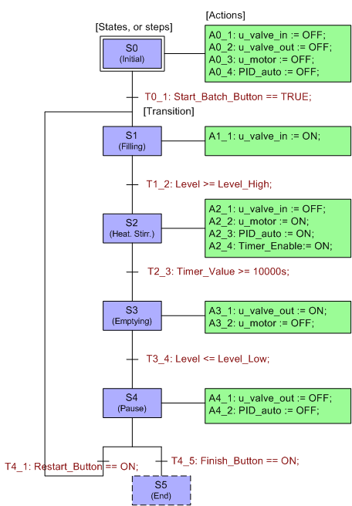
Steps (states)
Actions
Transitions

Slide 4
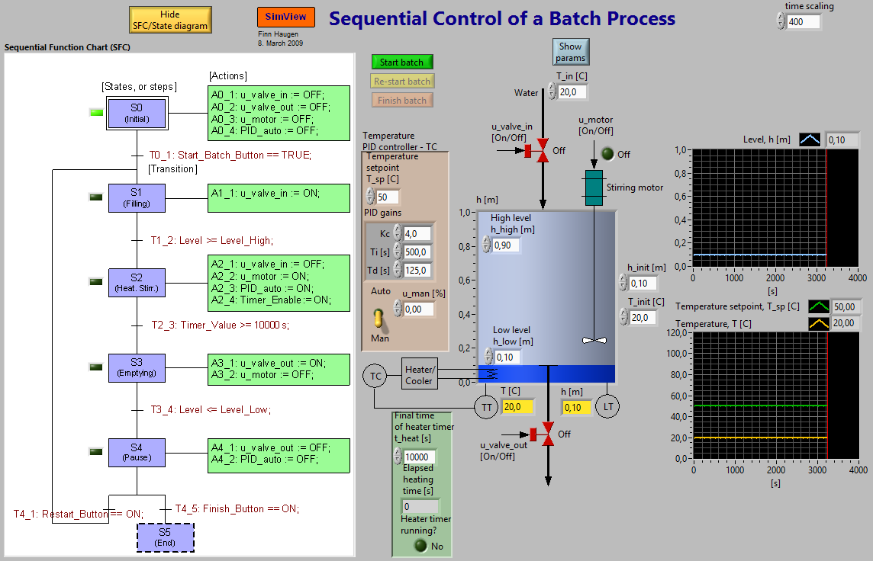
Example: Sequential control of batch process
Simulator

